Slide 1
Chapter 7: So long, farewell !
new words

Slide 2
yearbook

Slide 3
the football cup

Slide 4
Cantonese opera

Slide 5
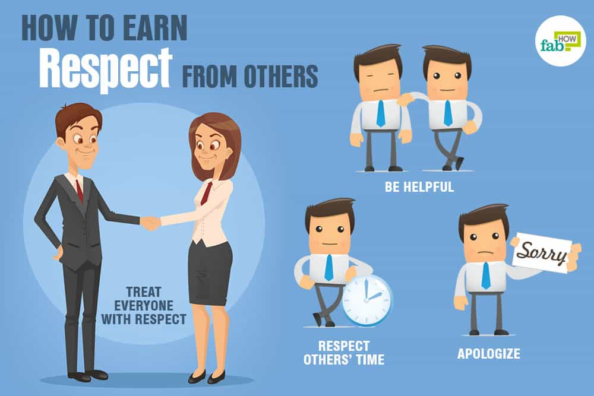
respect others

Slide 6
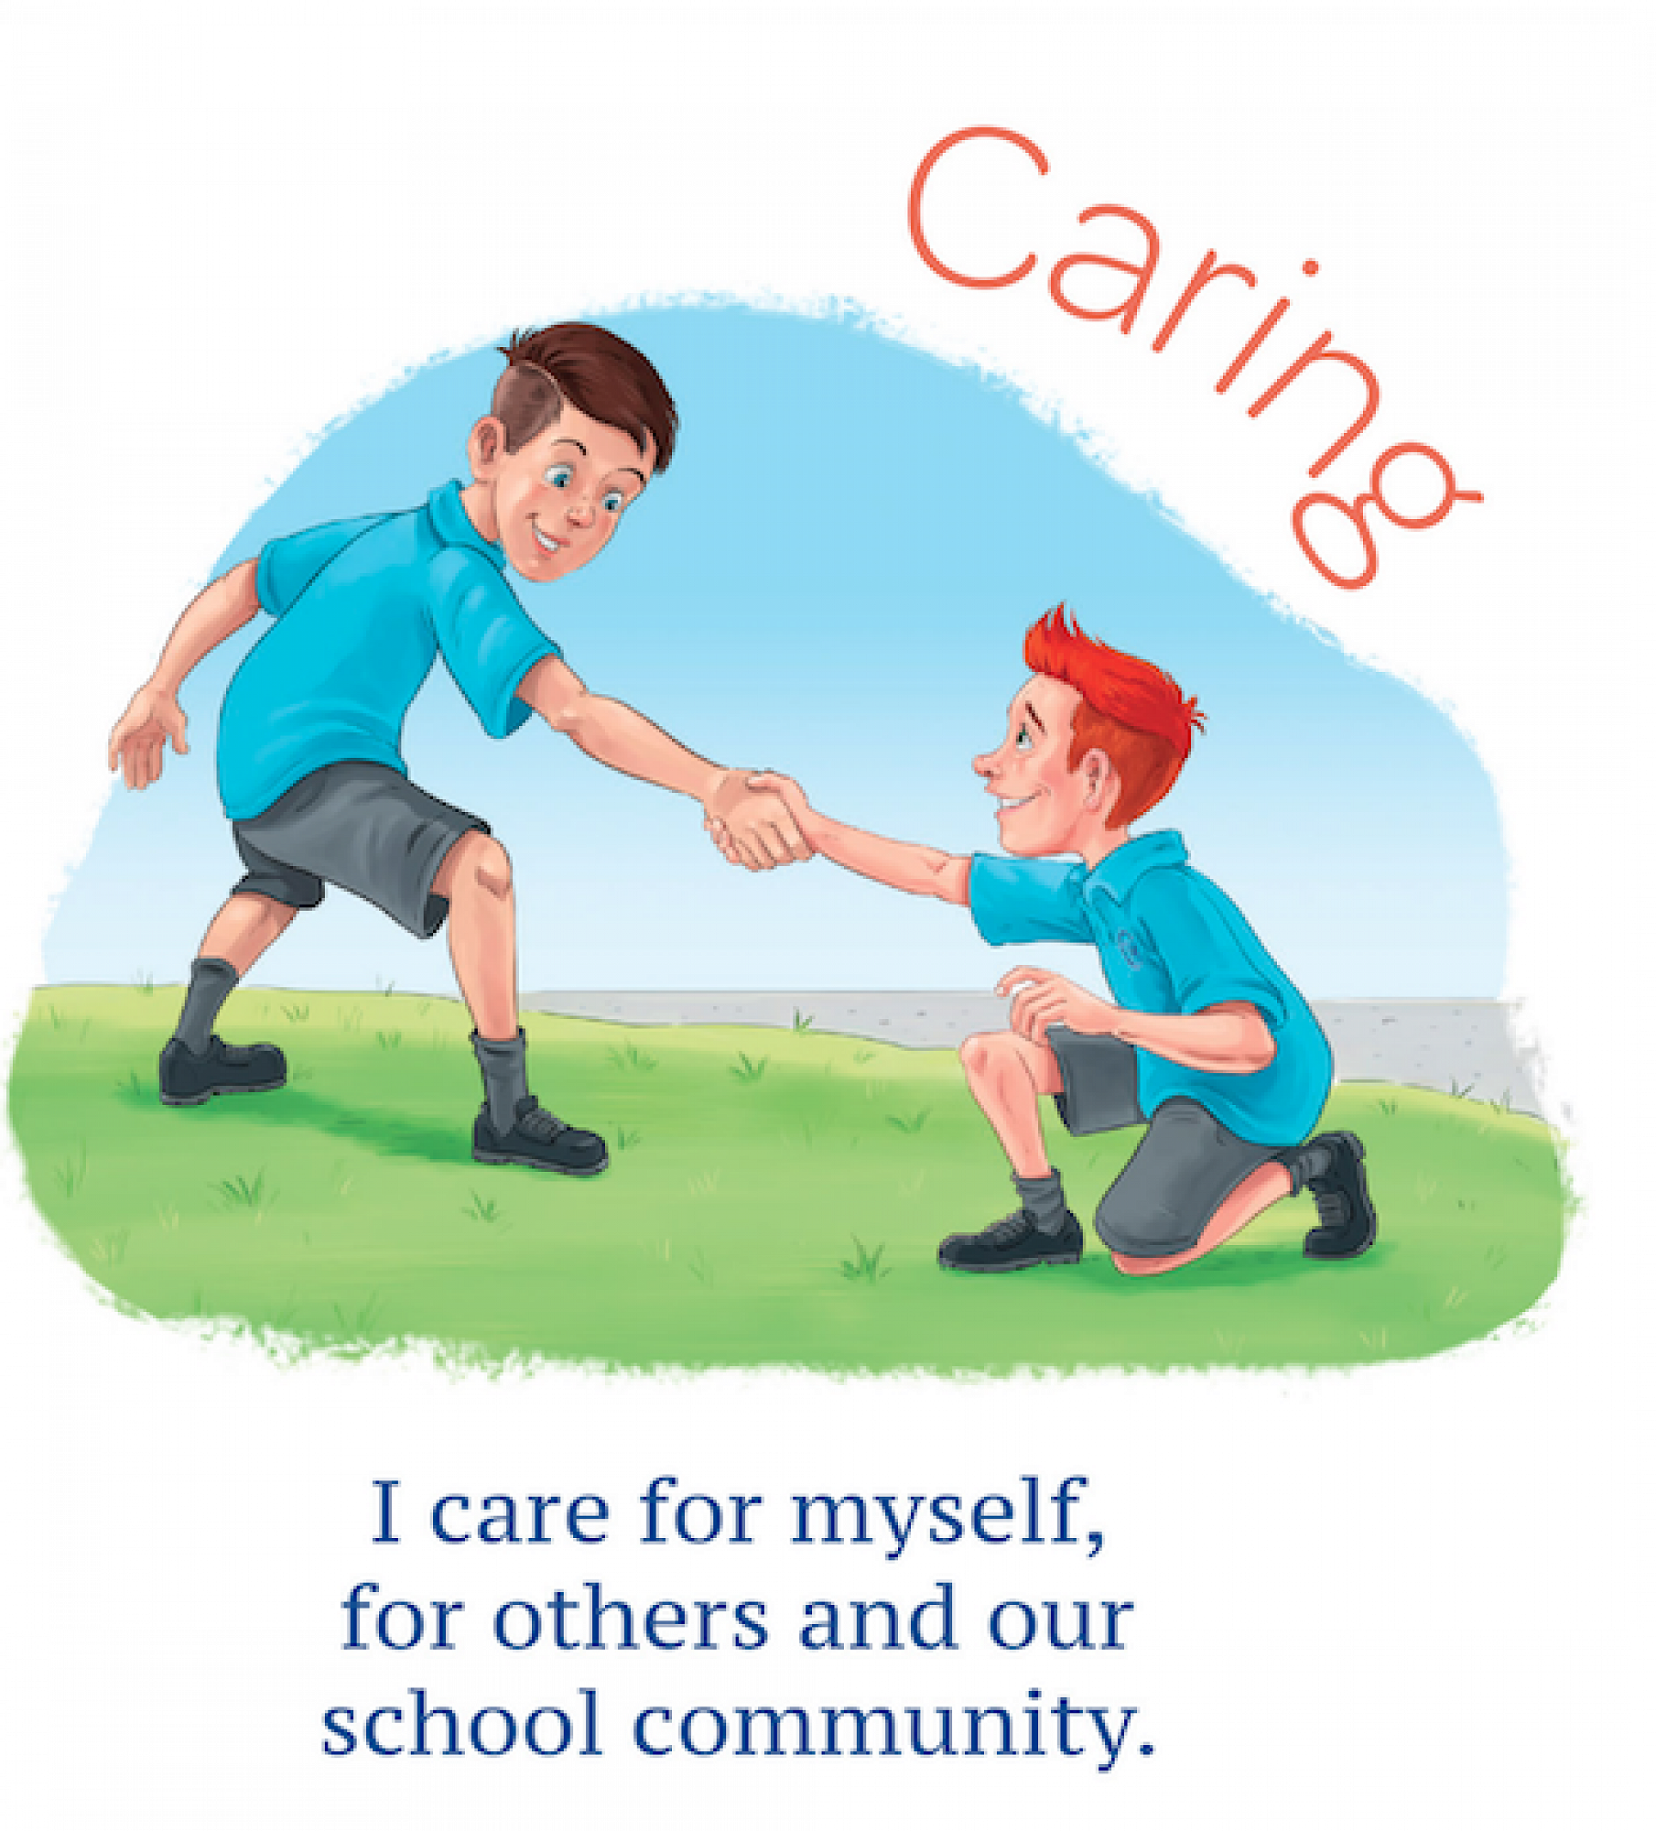
care for others

Slide 7
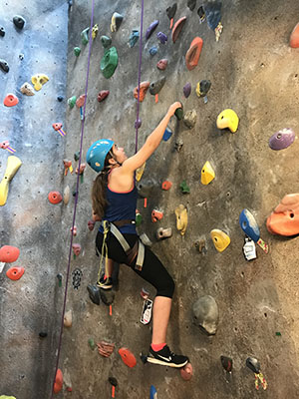
rock climbing

Slide 8
terrified

Slide 9
supportive

Slide 10
clapped and cheered

Slide 11
encouragement

Slide 12
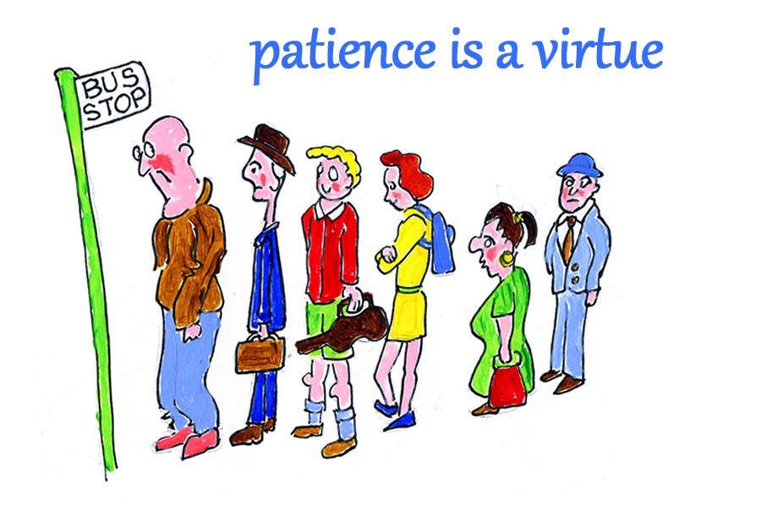
patience

Slide 13
well-behaved
√ √ √ √

Slide 14
haven’t(hadn’t) a clue

Slide 15
know right from wrong

Slide 16
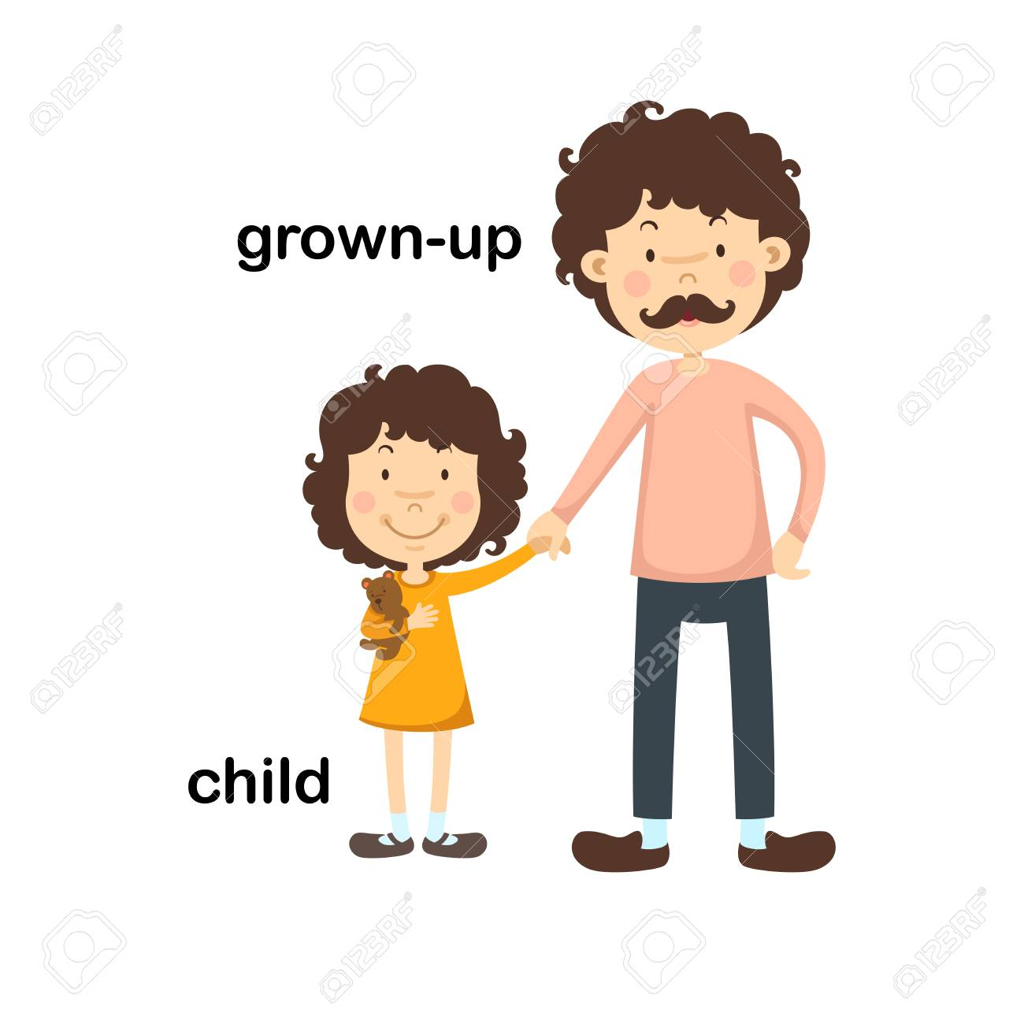

Slide 17
make choices

Slide 18
It is time to spread our wings.

Slide 19
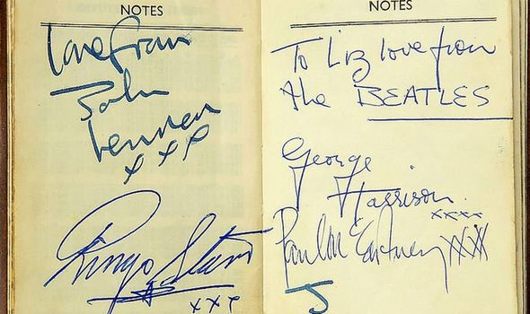
autographs

Slide 20
Scientists rule!

