Slide 1
Chapter 6: Memorable experiences
new words

Slide 2
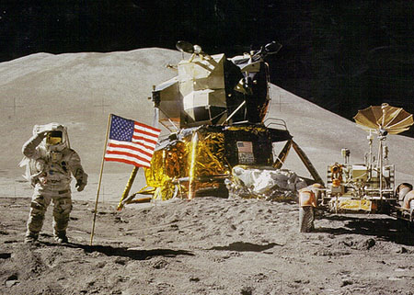
Apollo 11 project

Slide 3
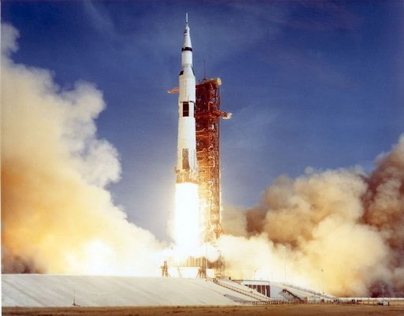
spacecraft

Slide 4
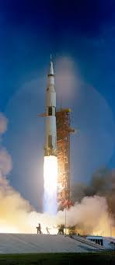
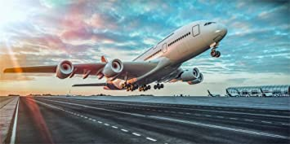
take off

Slide 5
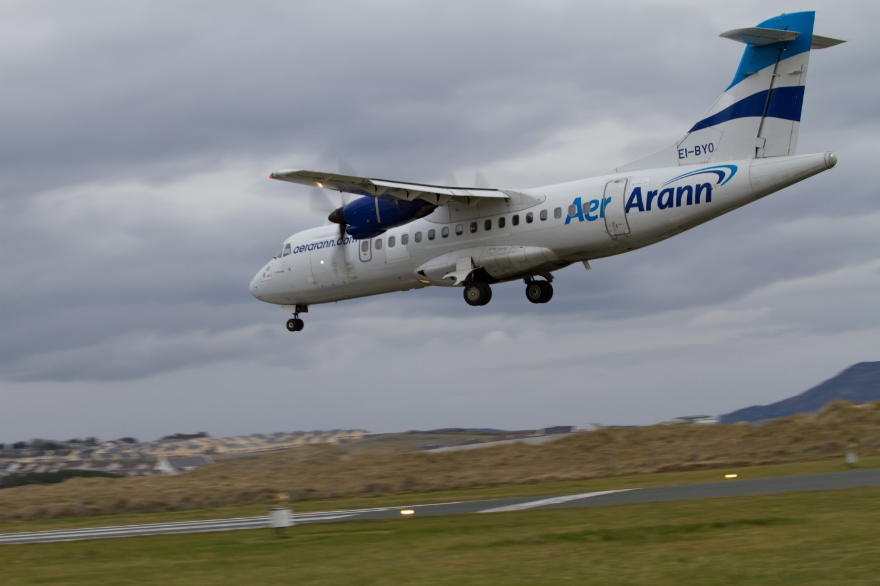
landing

Slide 6
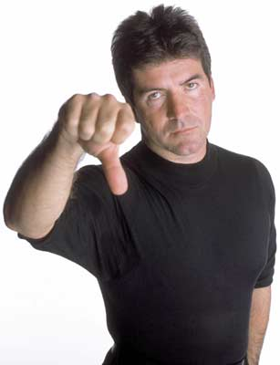
awful

Slide 7
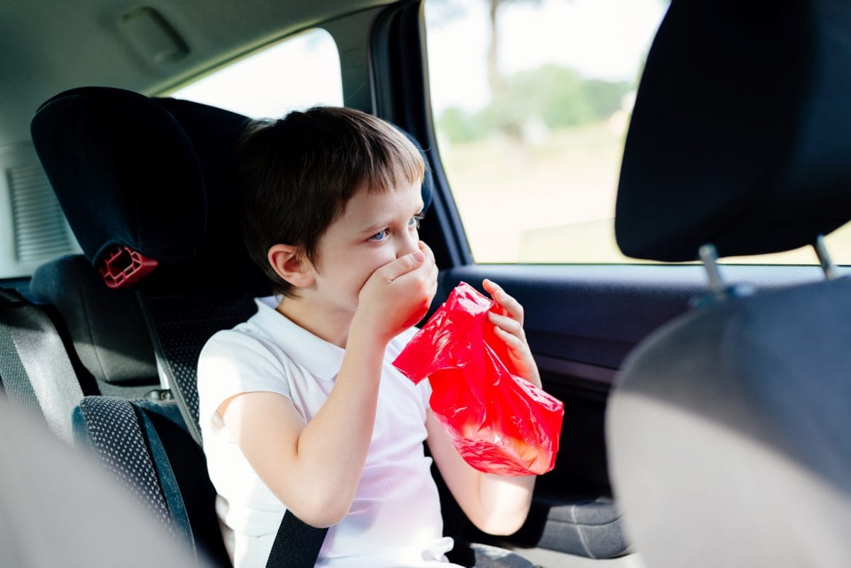
travel sickness

Slide 8
painful

Slide 9
bump into

Slide 10
floated around

Slide 11
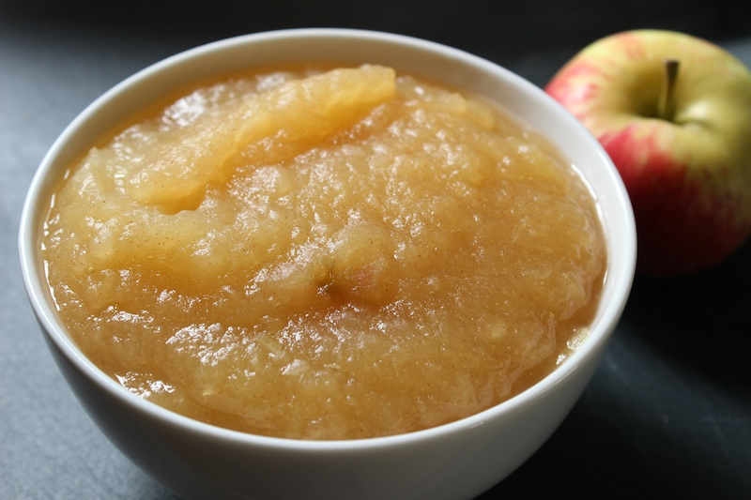
apple sauce

Slide 12
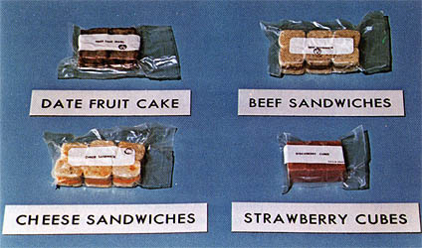
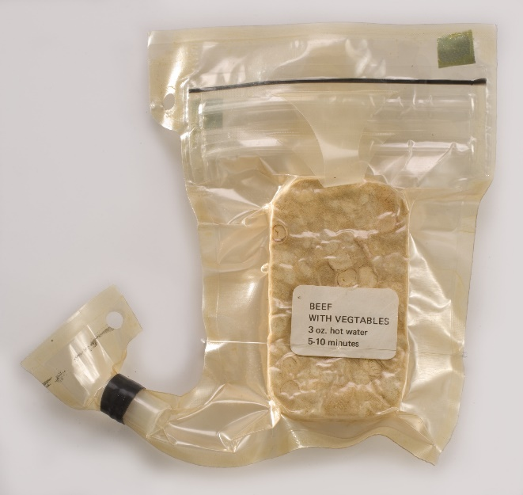
space food (50 years ago)
freeze-dried meals
beef with vegetables

Slide 13
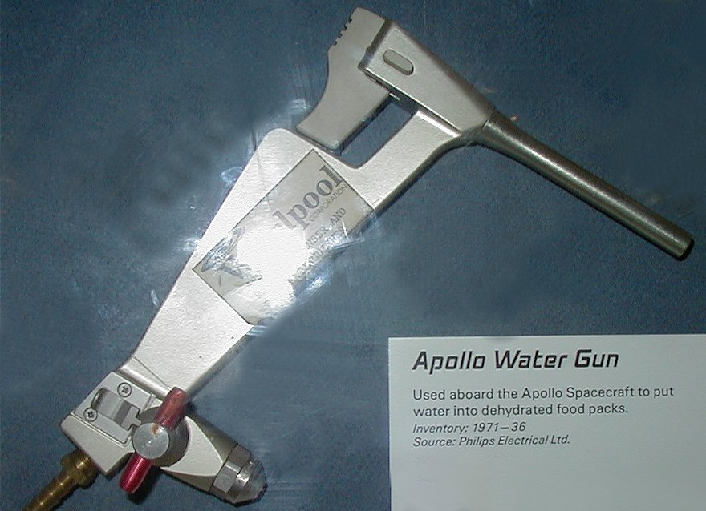
a water gun

Slide 14
squeeze

Slide 15
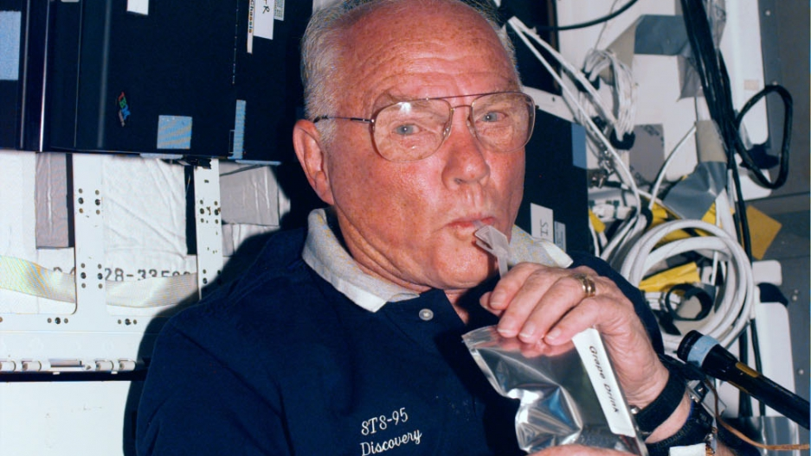
sucked the food through a tube

Slide 16
nervous

Slide 17
fuel

Slide 18
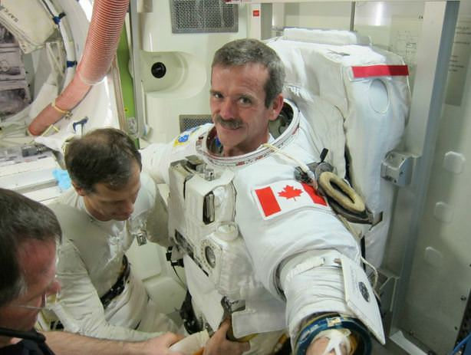
getting dressed

Slide 19
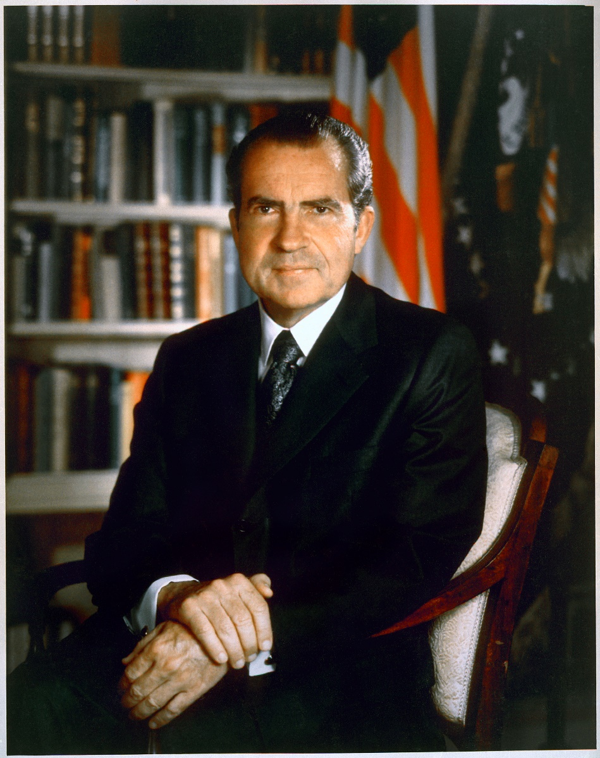
Richard Nixon the President of the USA, 1969

Slide 20
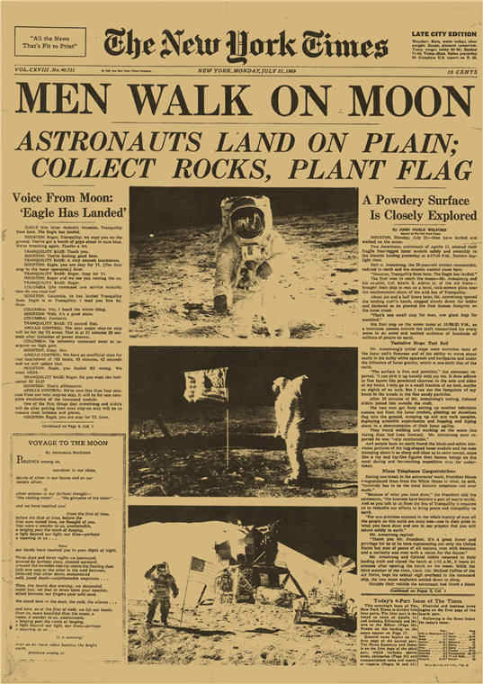
historic journey

Slide 21
Fun Facts

Slide 22
How did the astronauts eat?

Slide 23
FOOD in SPACE
Then
Now
Then

Slide 24
“One step for a man; a giant leap for mankind,” said Neil Armstrong. (1’04”- 1’10”)

