Slide 1
Chapter 5: Friendship
new words

Slide 2
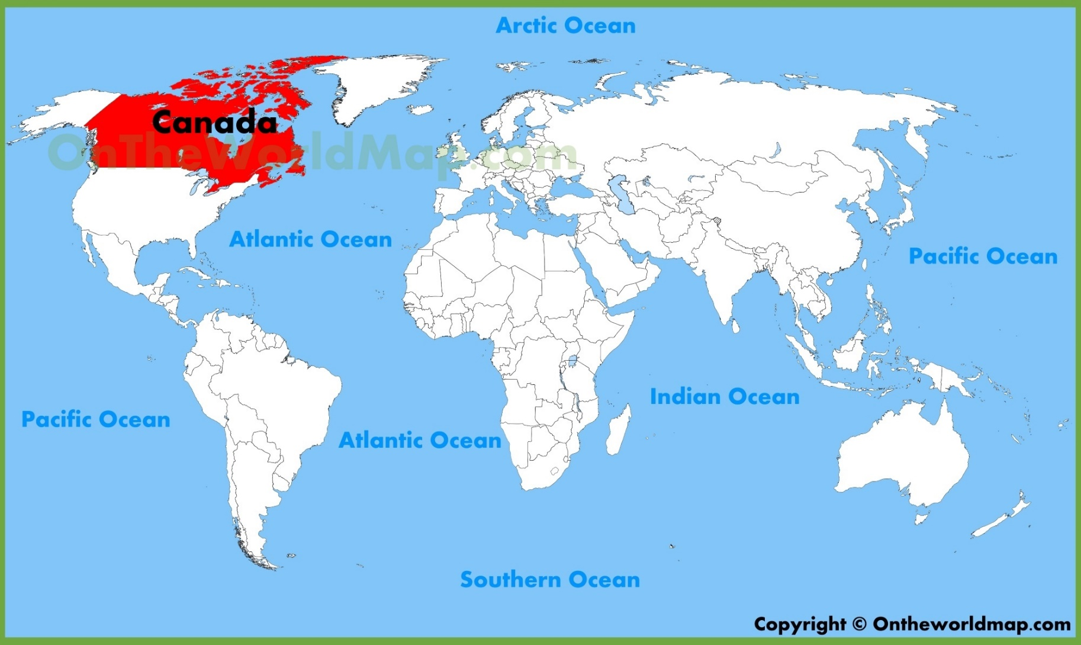
Canada

Slide 3
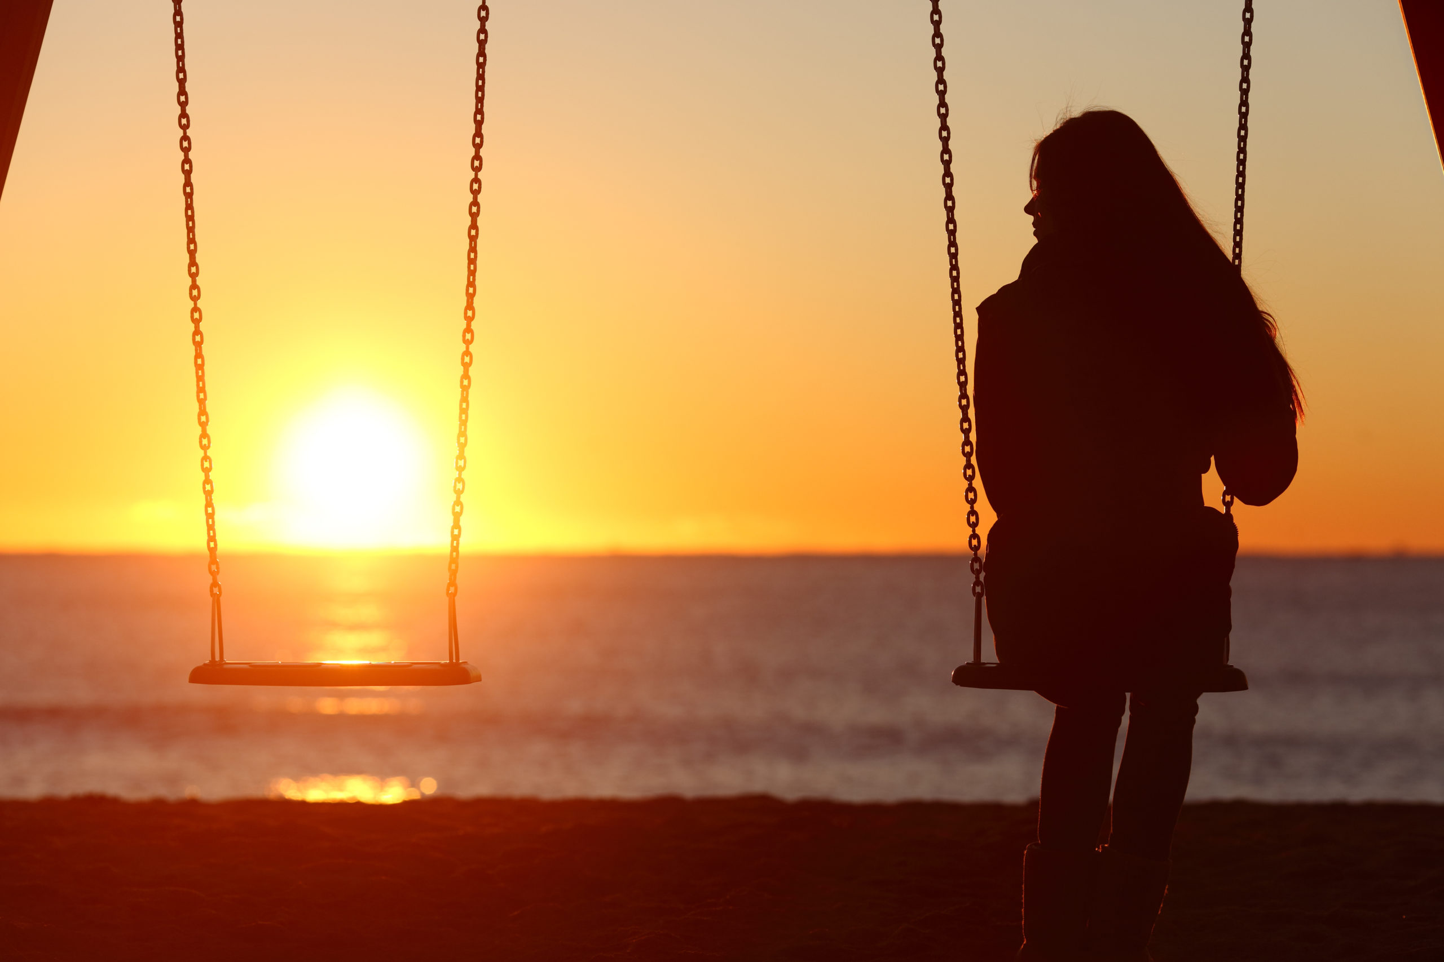
lonely

Slide 4
Harry Potter books

Slide 5
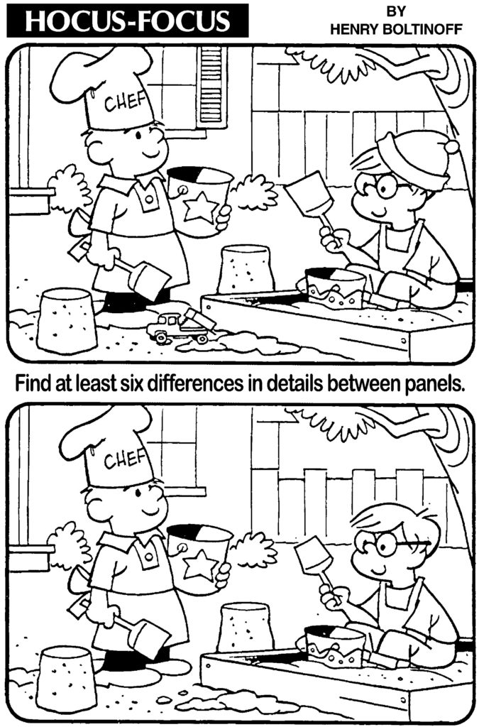
spotted e.g. Can you spot the differences?

Slide 6
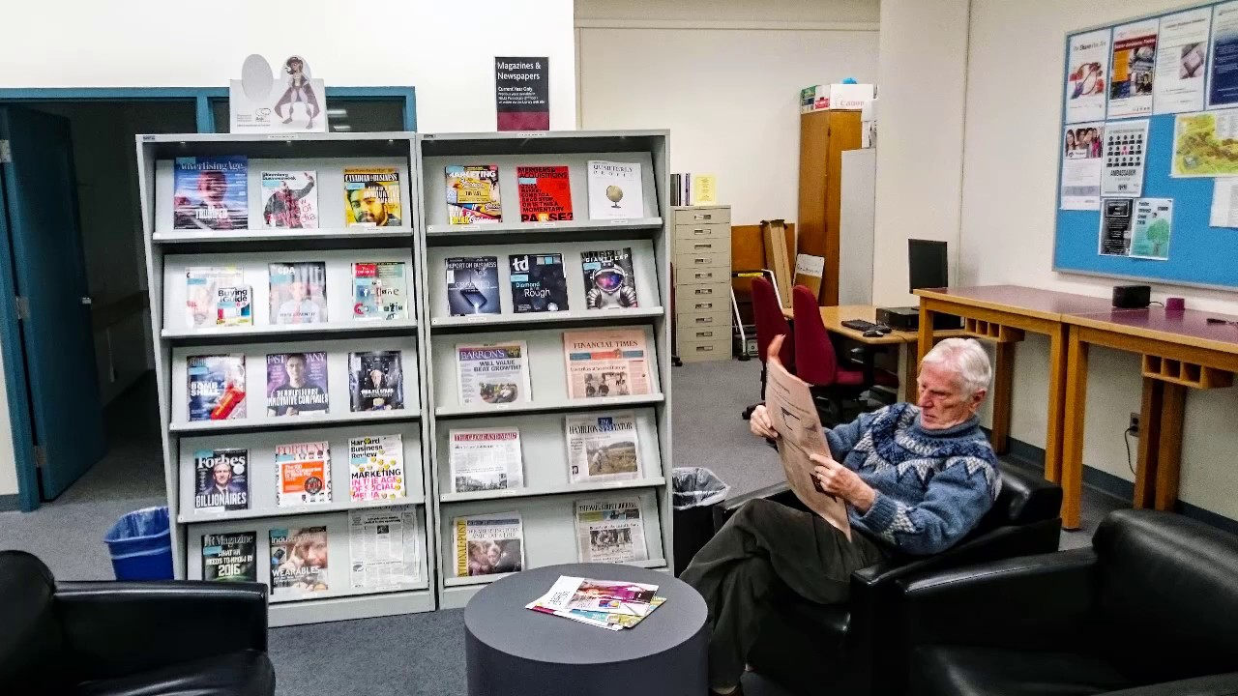
a display

Slide 7
the entrance

Slide 8
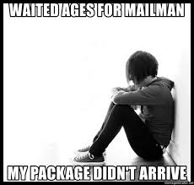
I’ve waited ages to read this. (= waited for a very long time)

Slide 9
My face fell. (= started to look unhappy)

Slide 10
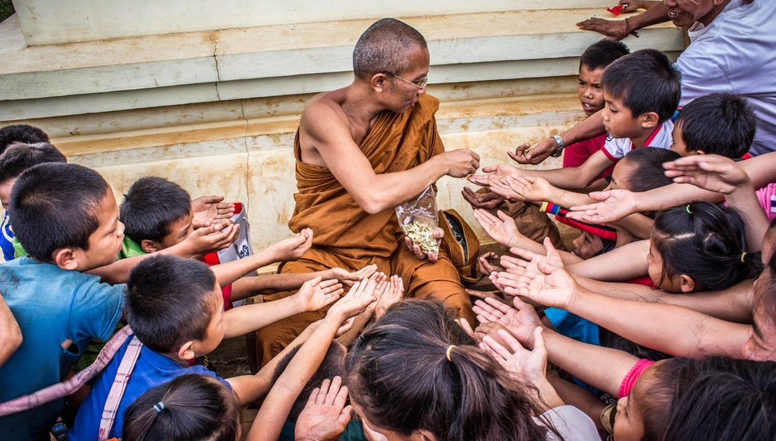
generous

Slide 11
chatted

Slide 12
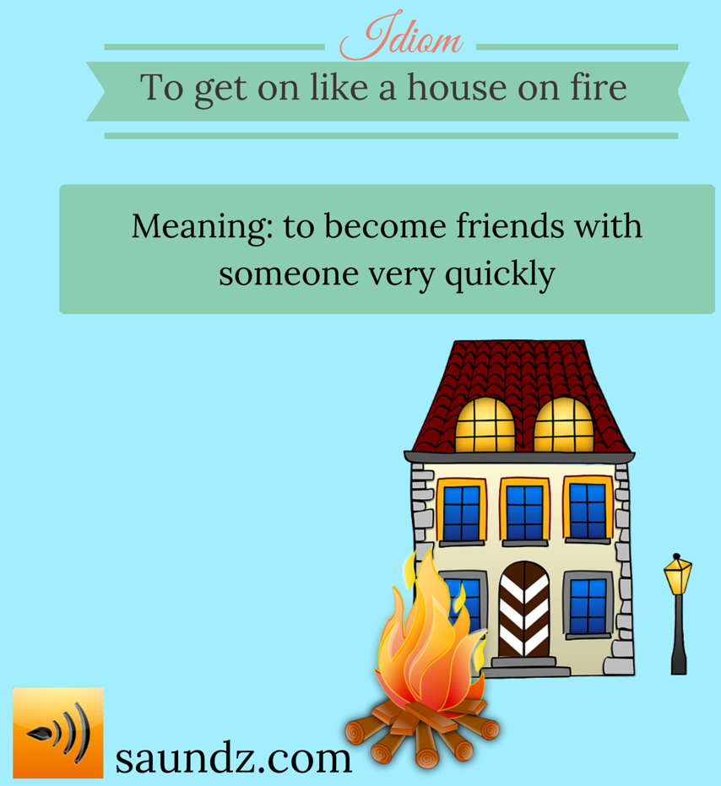
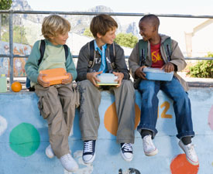
We got on like a house on fire.

Slide 13
I arrived at 10 o’clock on the dot.

Slide 14
punctual

Slide 15
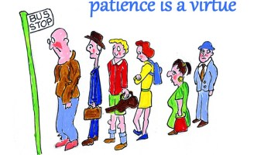
wait patiently

Slide 16
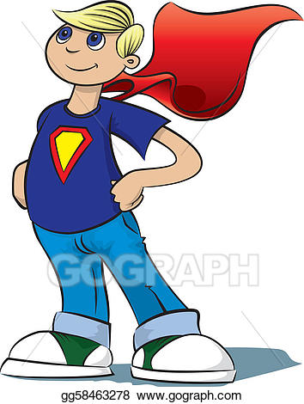
pretend

Slide 17
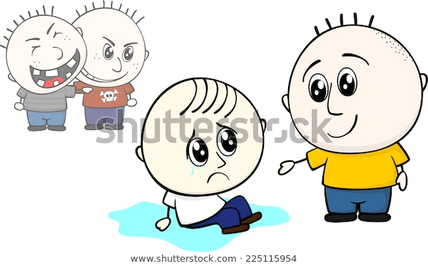
offer to help

Slide 18
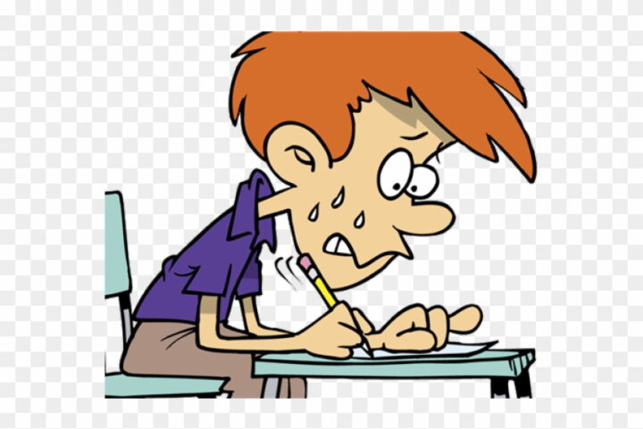
nervous

Slide 19
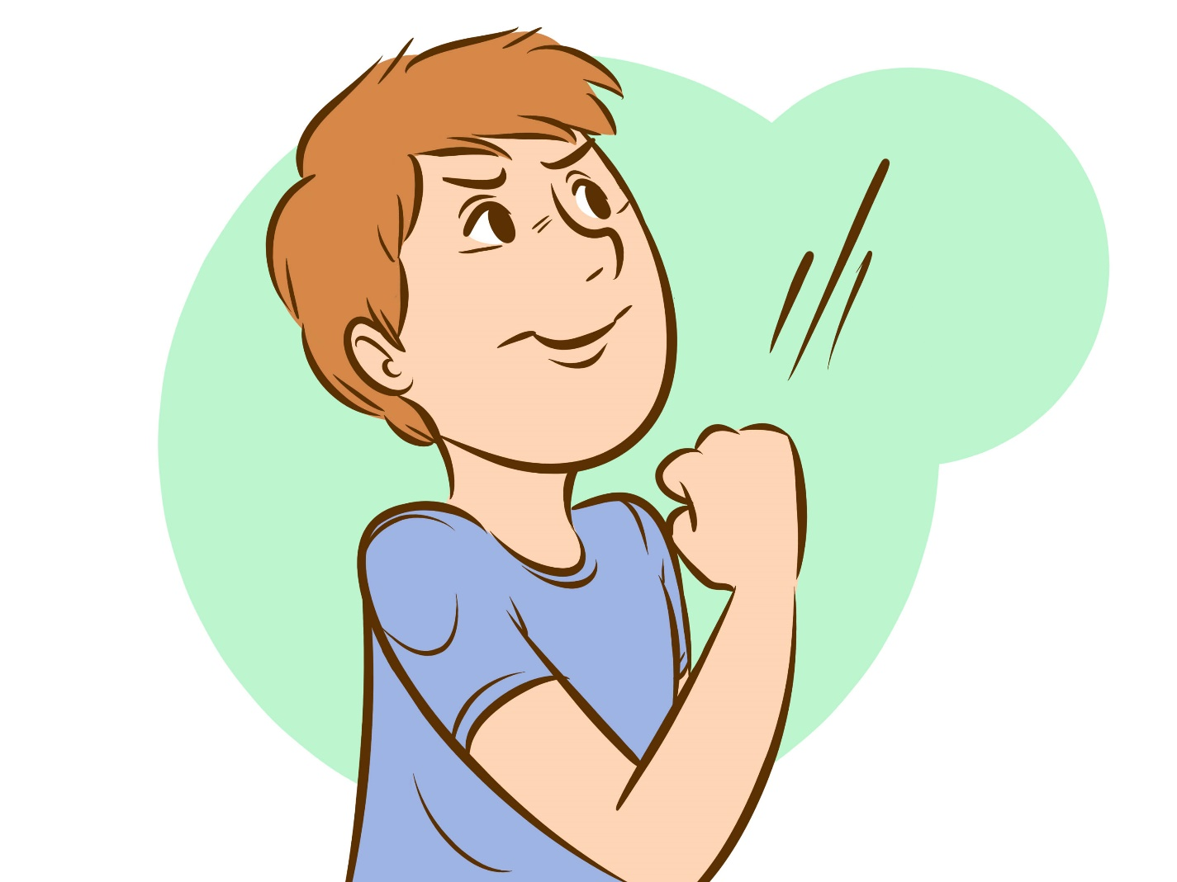
confident
I can do it!

Slide 20
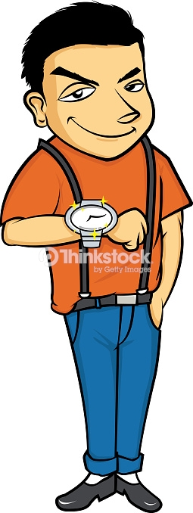
show off
$$$

Slide 21
modest

Slide 22
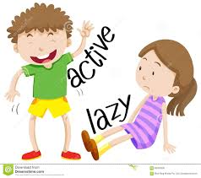
active
≠

Slide 23
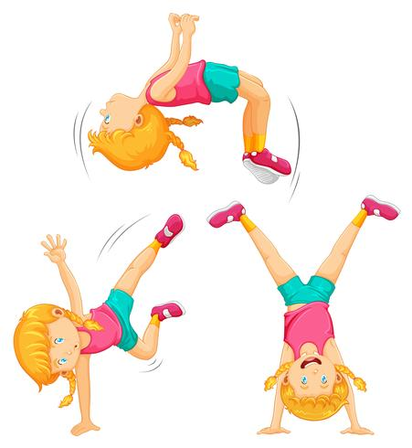
energetic

Slide 24
a shop assistant

Slide 25
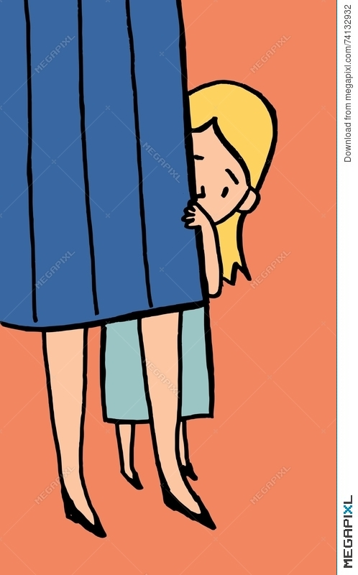
shy

