Slide 1
Chapter 2: Ways to get around

Slide 2
chat

Slide 3
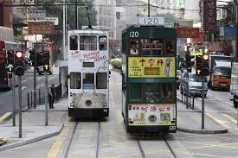
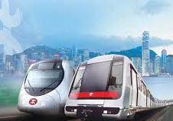
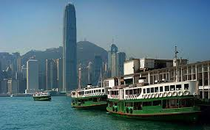
transport
trams, trains, ferries

Slide 4
brilliant

Slide 5
crazy about

Slide 6
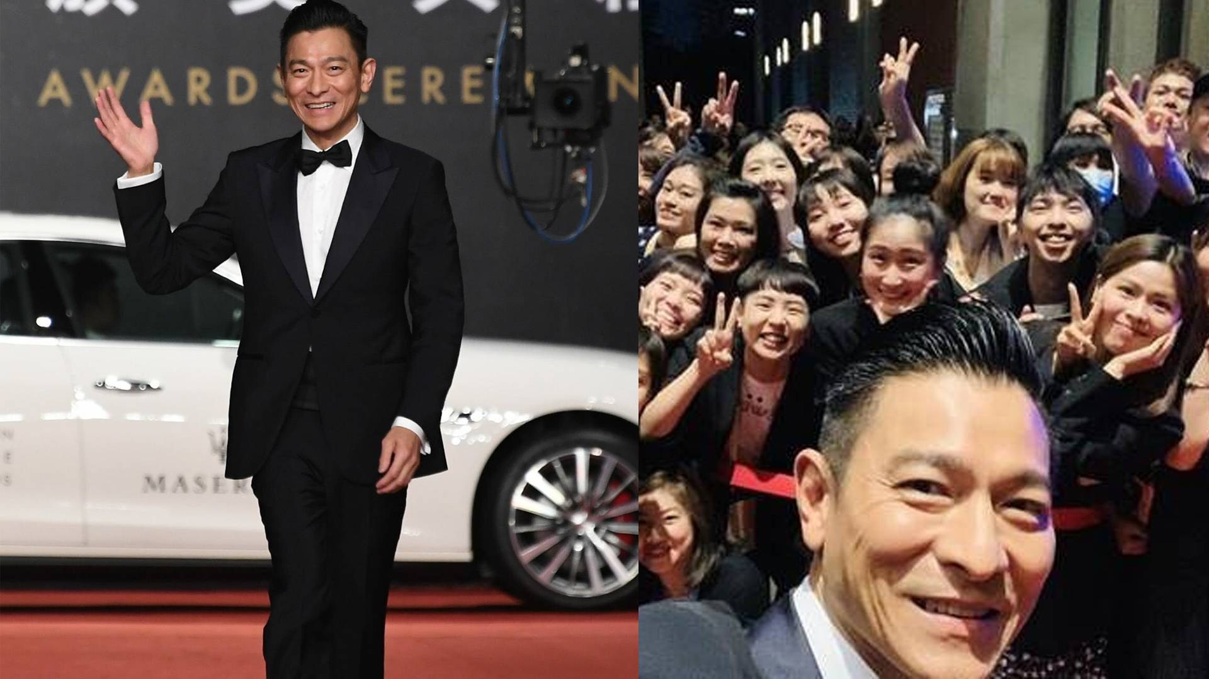
Andy Lau and his fans

Slide 7
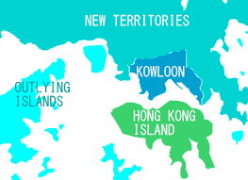
Hong Kong Island

Slide 8
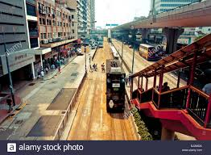
street views

Slide 9
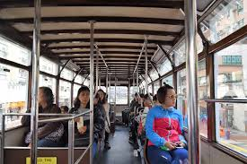
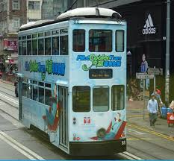
sitting upstairs

Slide 10
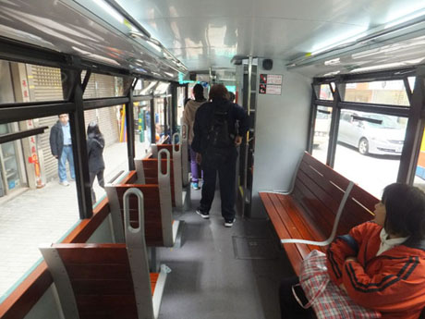
hard seats

Slide 11
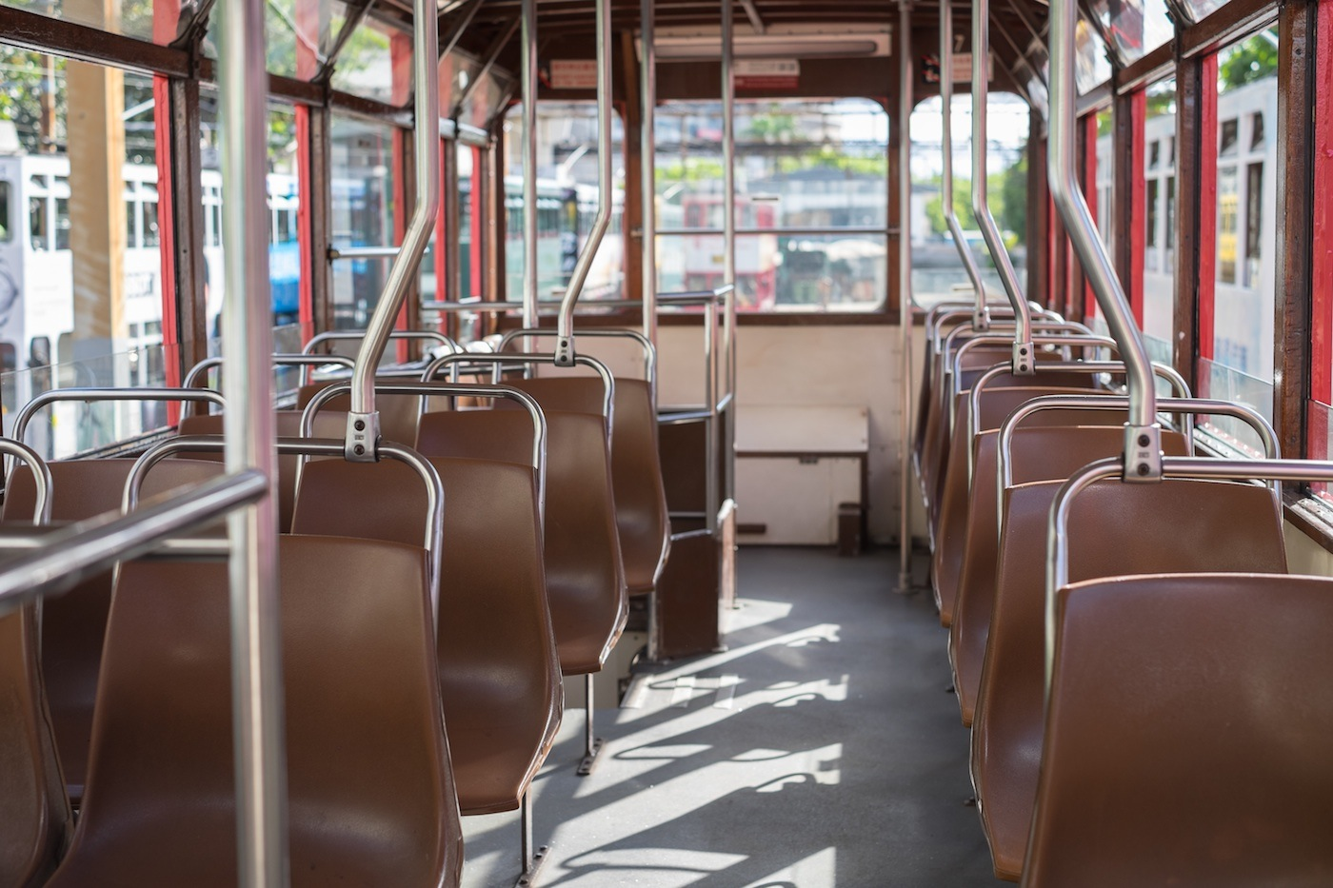
uncomfortable

Slide 12
a cushion

Slide 13
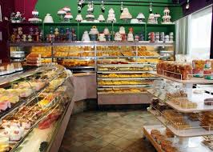
a bakery

Slide 14
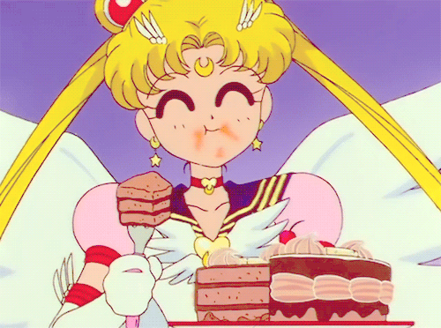
It makes my mouth water!

Slide 15
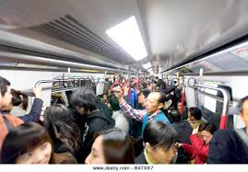
crowded

Slide 16
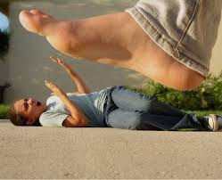
get squashed

Slide 17
relaxing

Slide 18
sea breeze

Slide 19
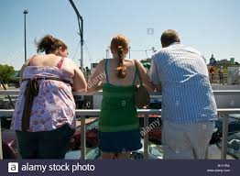
lean on the rail

Slide 20
a tourist

Slide 21
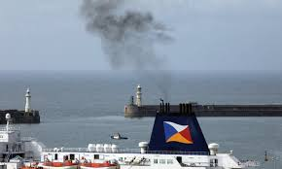
the smell of the fuel

Slide 22
convenient

Slide 23
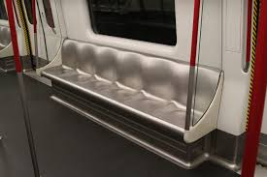
metal seats

Slide 24
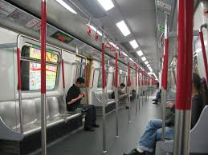
passengers

Slide 25
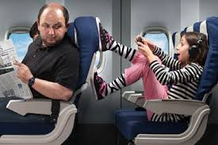
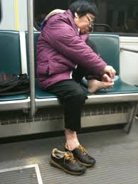
rude

Slide 26
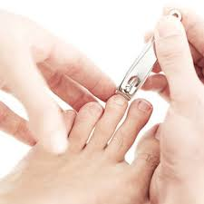
toenails

Slide 27
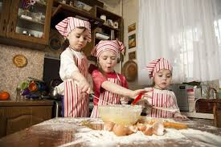
make a mess

