Slide 1
Chapter 1: A fun day out
new words

Slide 2
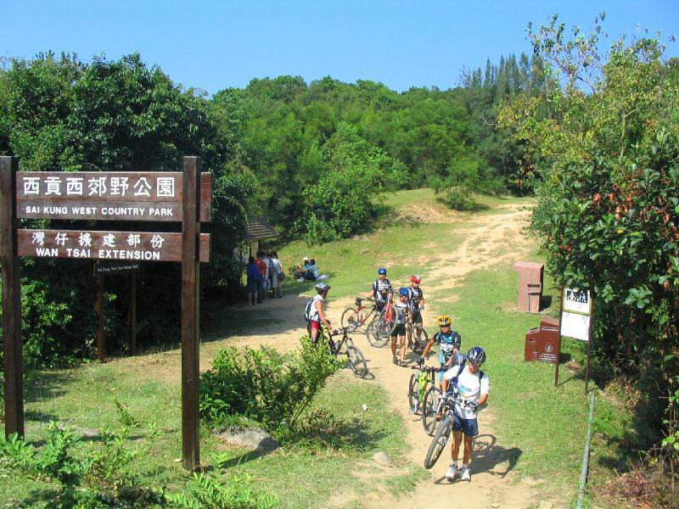
a country park

Slide 3
leisure

Slide 4
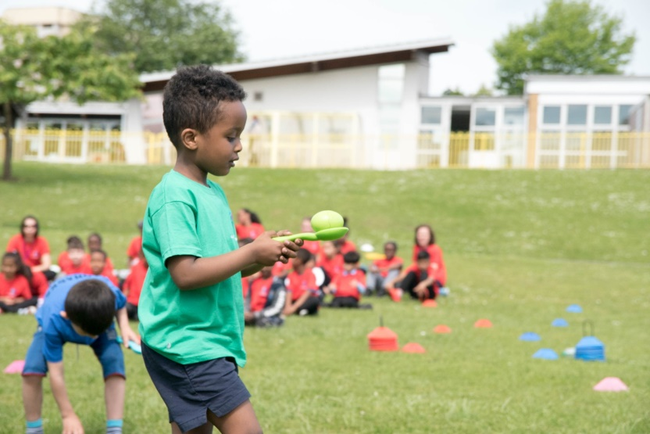
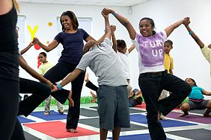
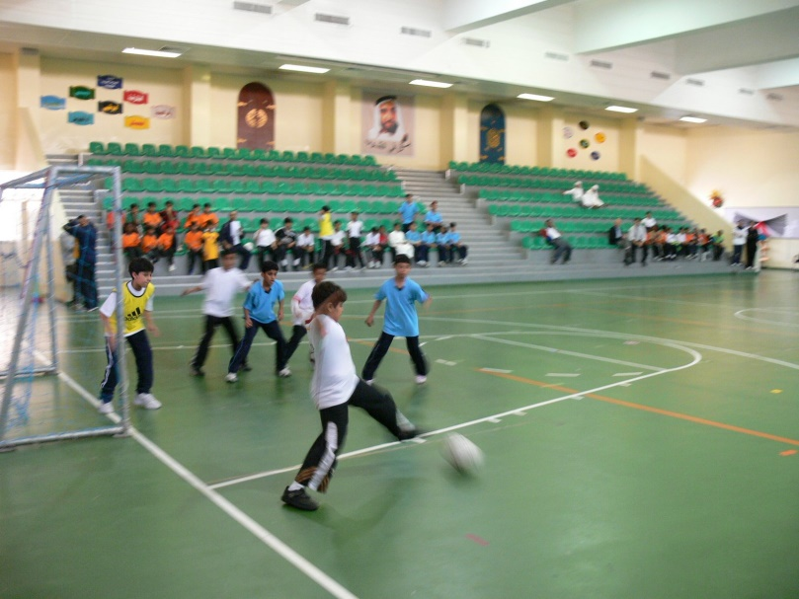
leisure club activities

Slide 5
a coach

Slide 6
upset

Slide 7
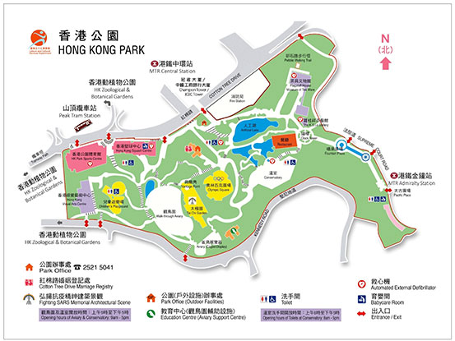
a map

Slide 8
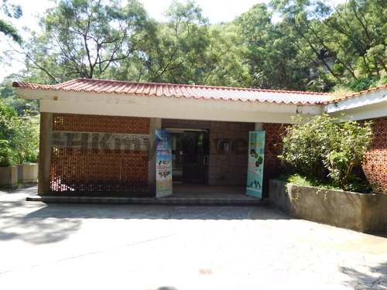
a visitor centre

Slide 9
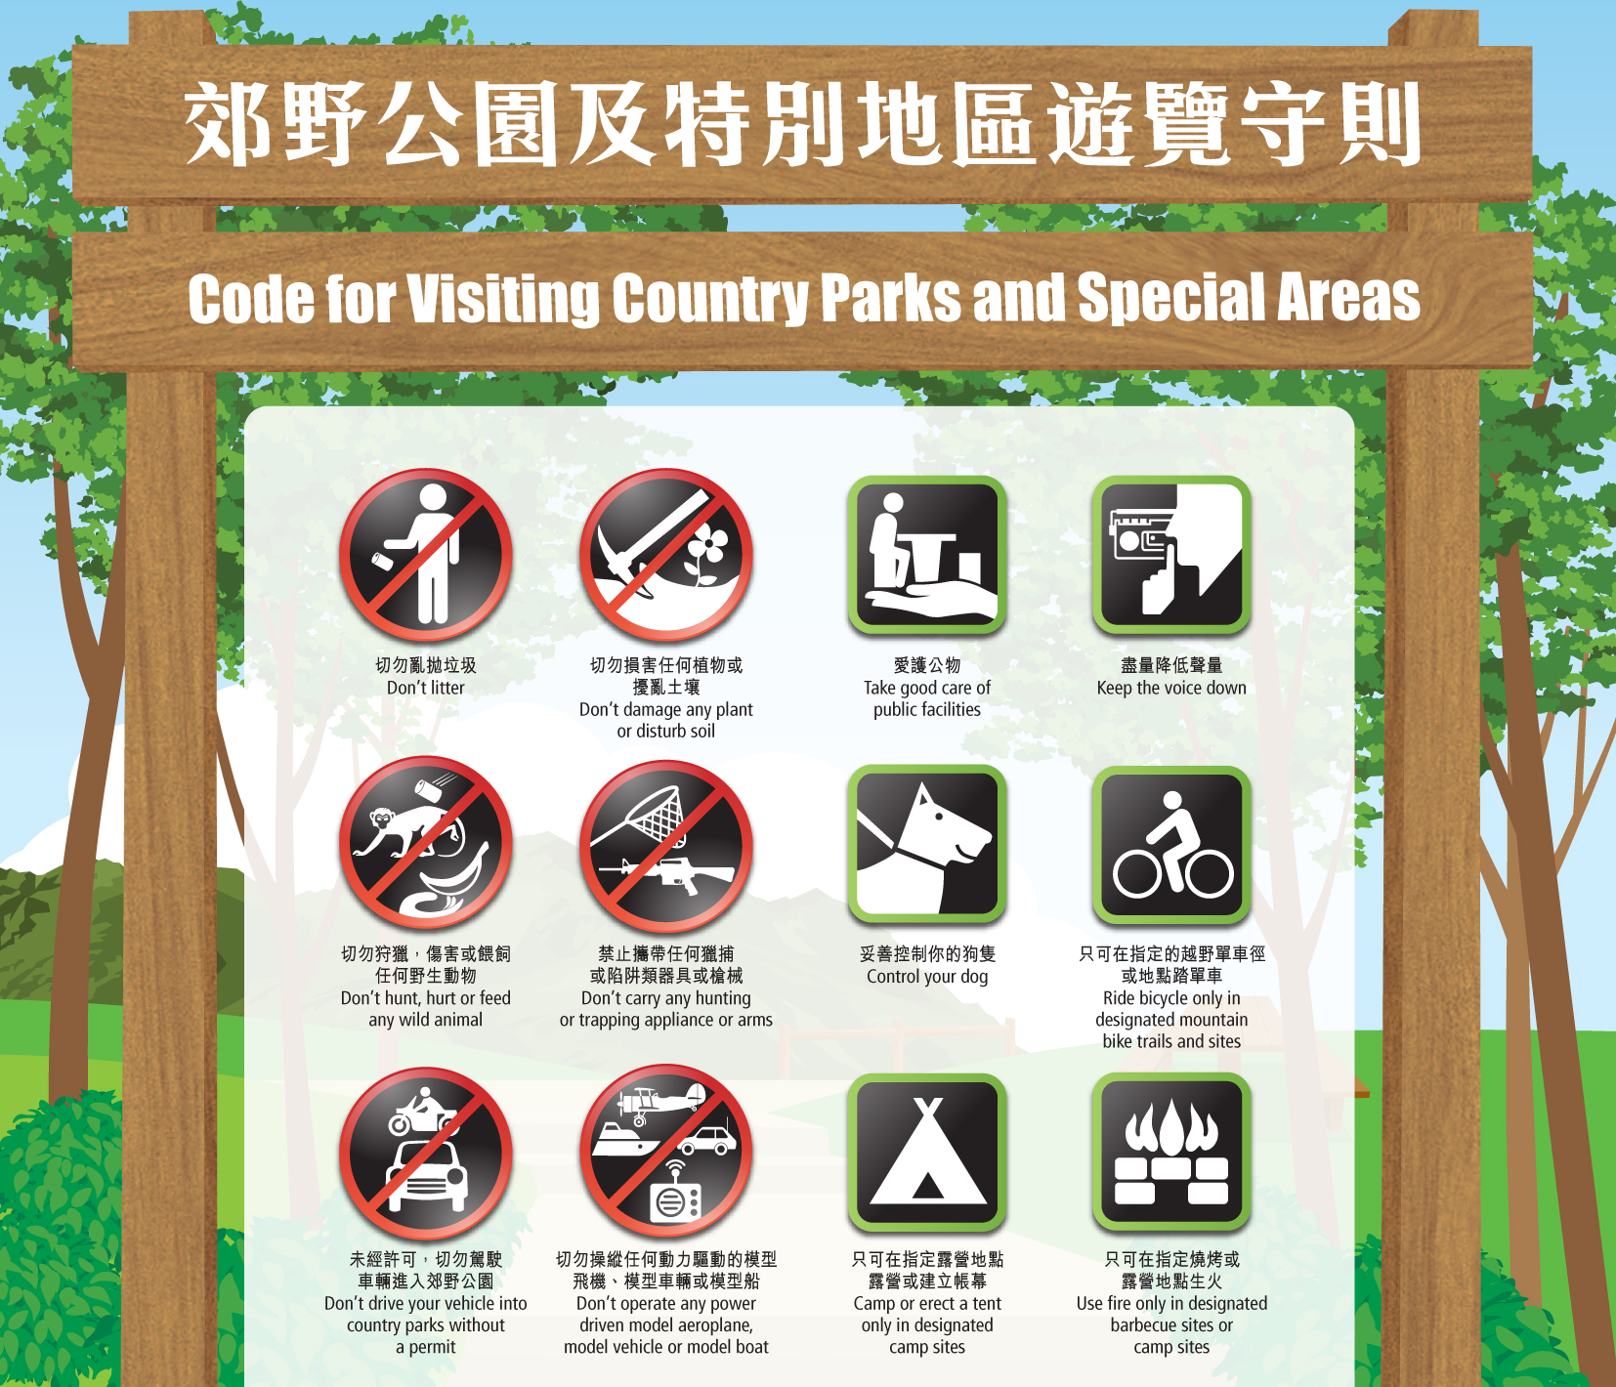
the Country Code

Slide 10
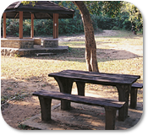
a picnic site

Slide 11
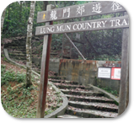
a hiking trail

Slide 12
a campsite

Slide 13
a barbecue site

Slide 14
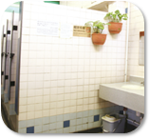
a public toilet

Slide 15
a public telephone

Slide 16
a short cut

Slide 17
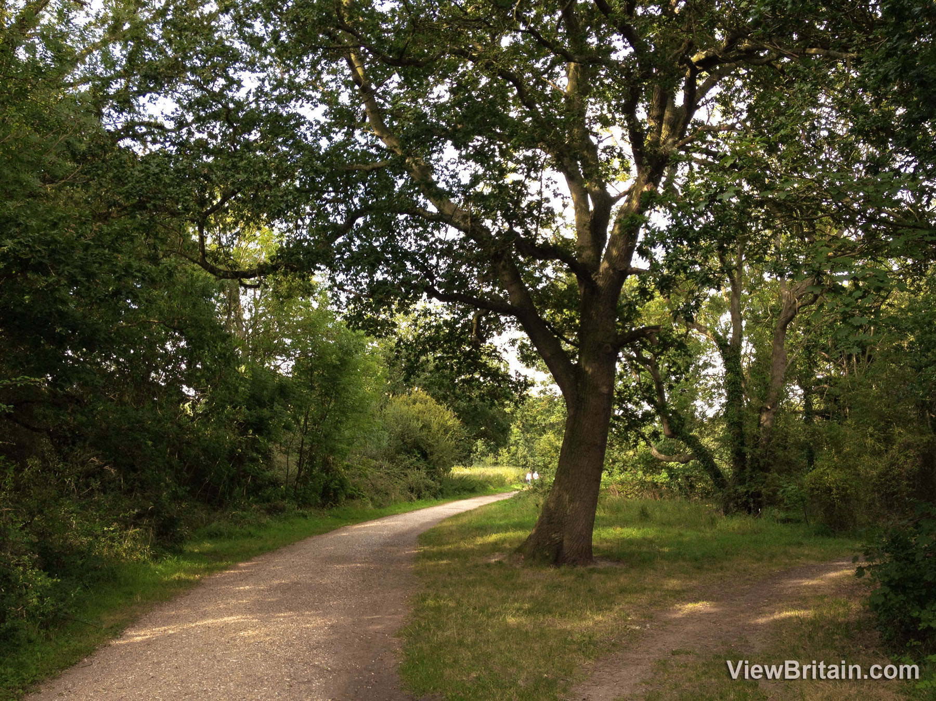
a path

Slide 18
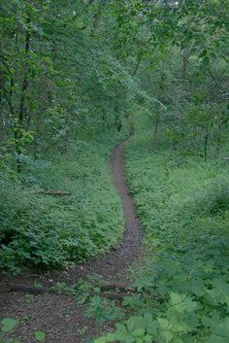
a narrow path

Slide 19
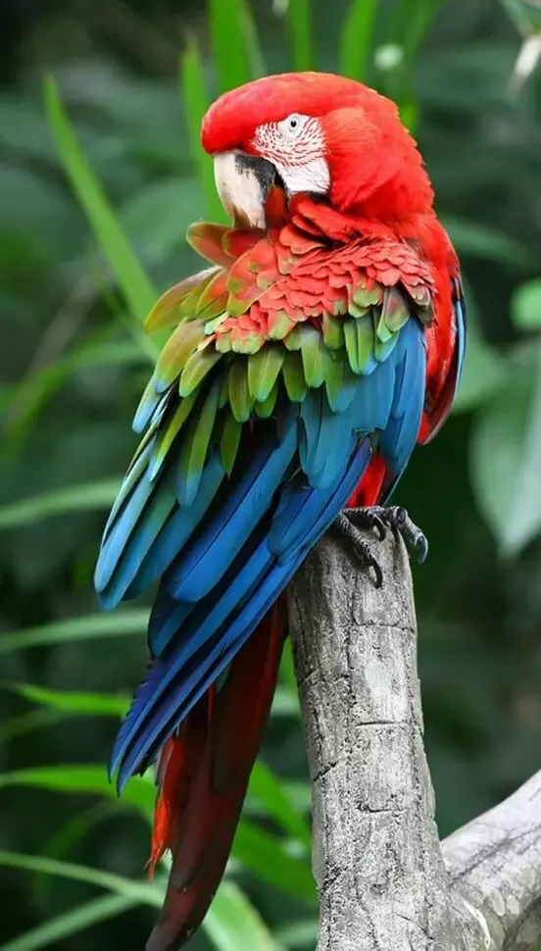
a brightly-coloured parrot

