Slide 1
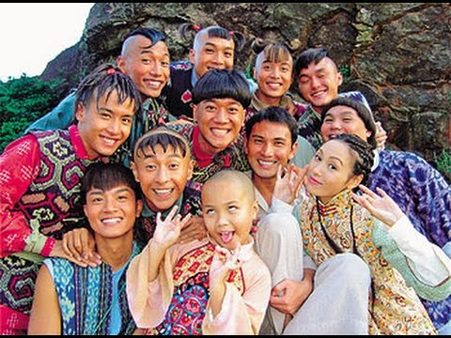
The Ten Brothers (Part 1)
The Ten Brothers

Slide 2
Is this a story?
1. Who are the characters?
2. What can you see on
the left- hand side?
Where did the act take place?
2. When did the act take place?
1. How does Ming speak?
2. When the Ten Brothers
enter the village, what do
the villagers do?

Slide 3
This is a play
Character list – a list of
people in the play
Setting – where and when the
act or scene takes place
Stage direction – what the
characters do and how they
speak / act
(excitedly)
(everyone cheers)

