Slide 1
Text 3.2: Read and Discover
new words

Slide 2
a leaflet (leaflets)
Starwood Theatre

Slide 3
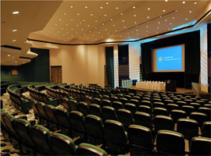
a theatre

Slide 4
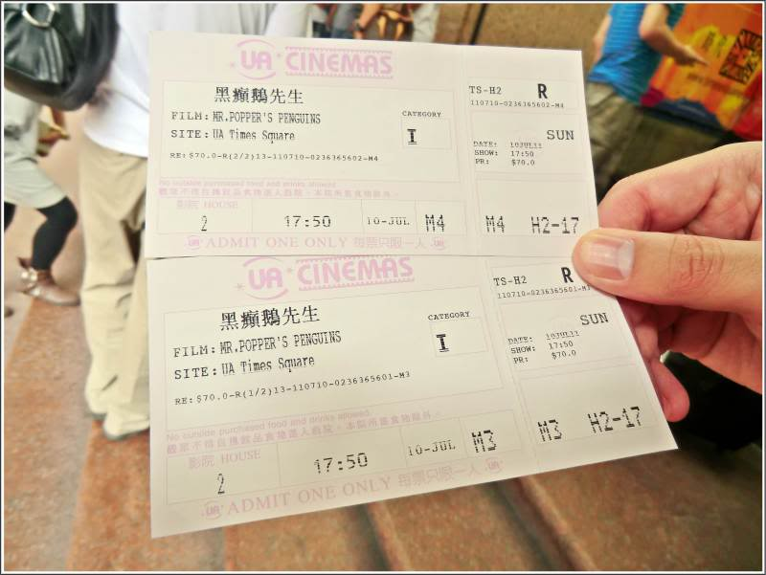
tickets

Slide 5
evening performance
matinee performance
adults
senior citizens
students
intermission

