Slide 1
Chapter 3: Green living
Global warming
new words

Slide 2
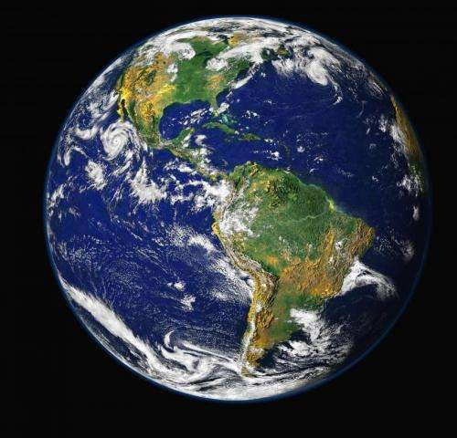
the Earth

Slide 3
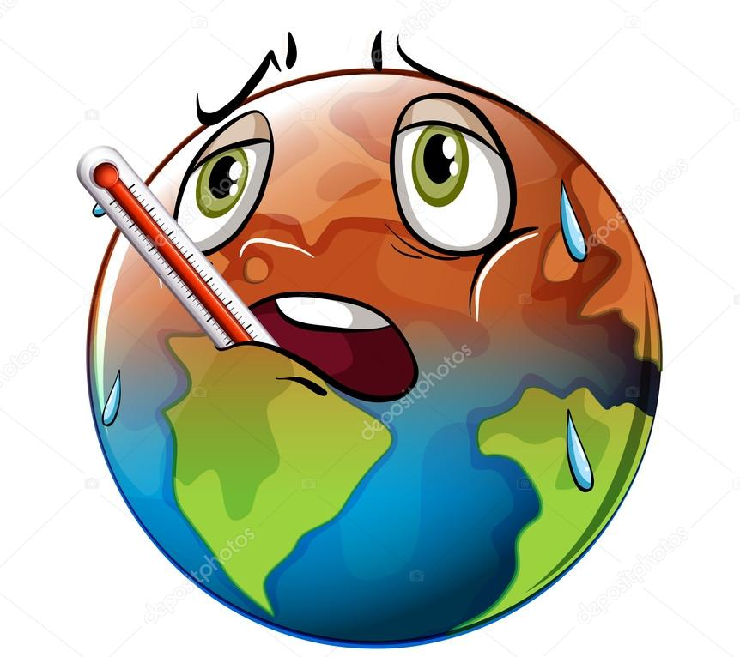
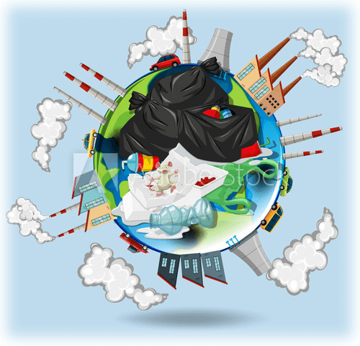
global warming

Slide 4
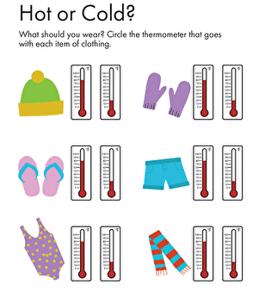
temperature

Slide 5
increase(increasing)

Slide 6
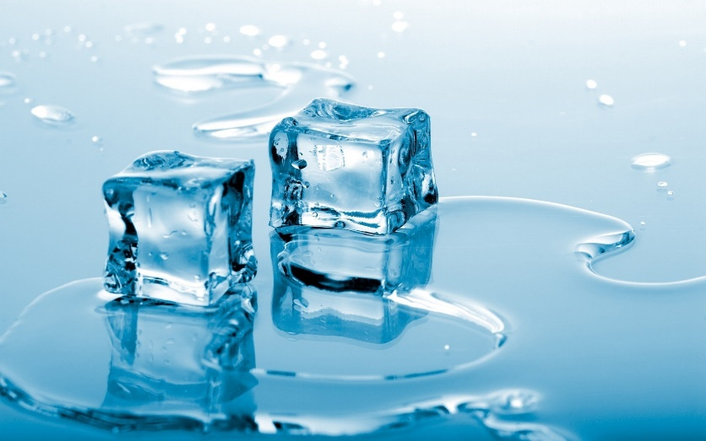
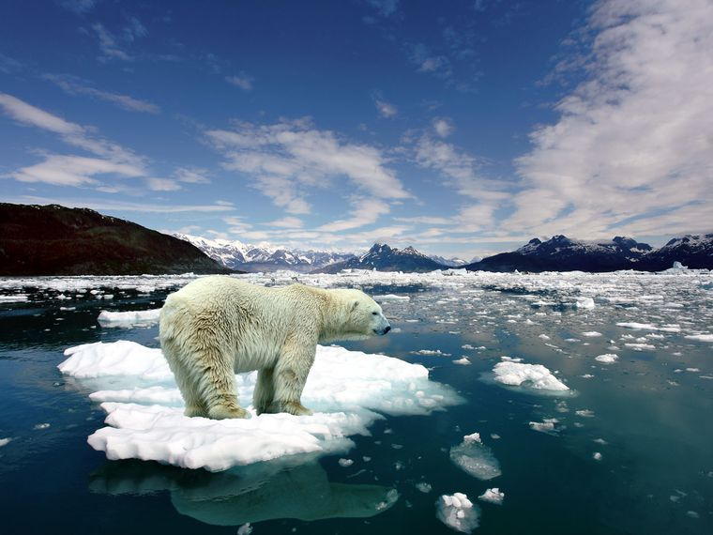
melt(melting)

Slide 7
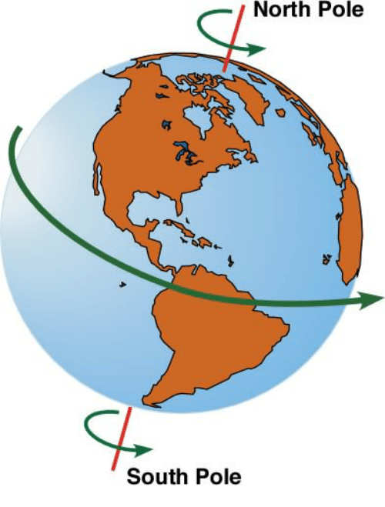
the North Pole
the South Pole

Slide 8
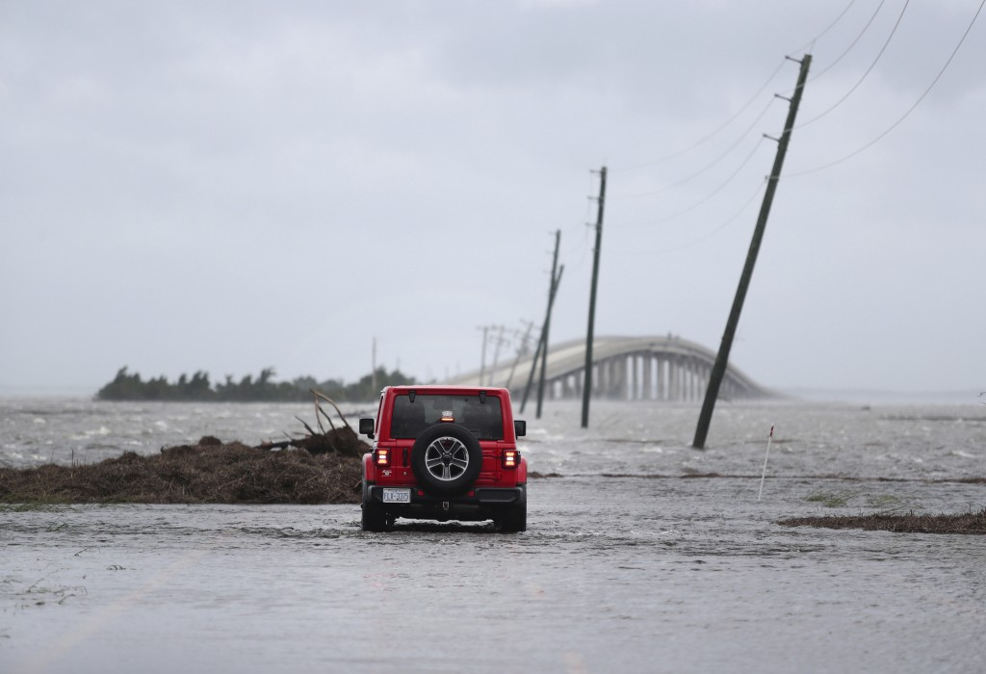
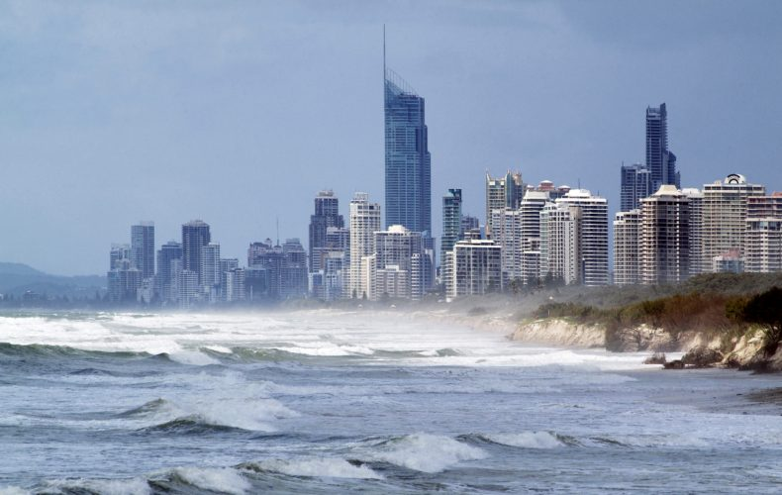
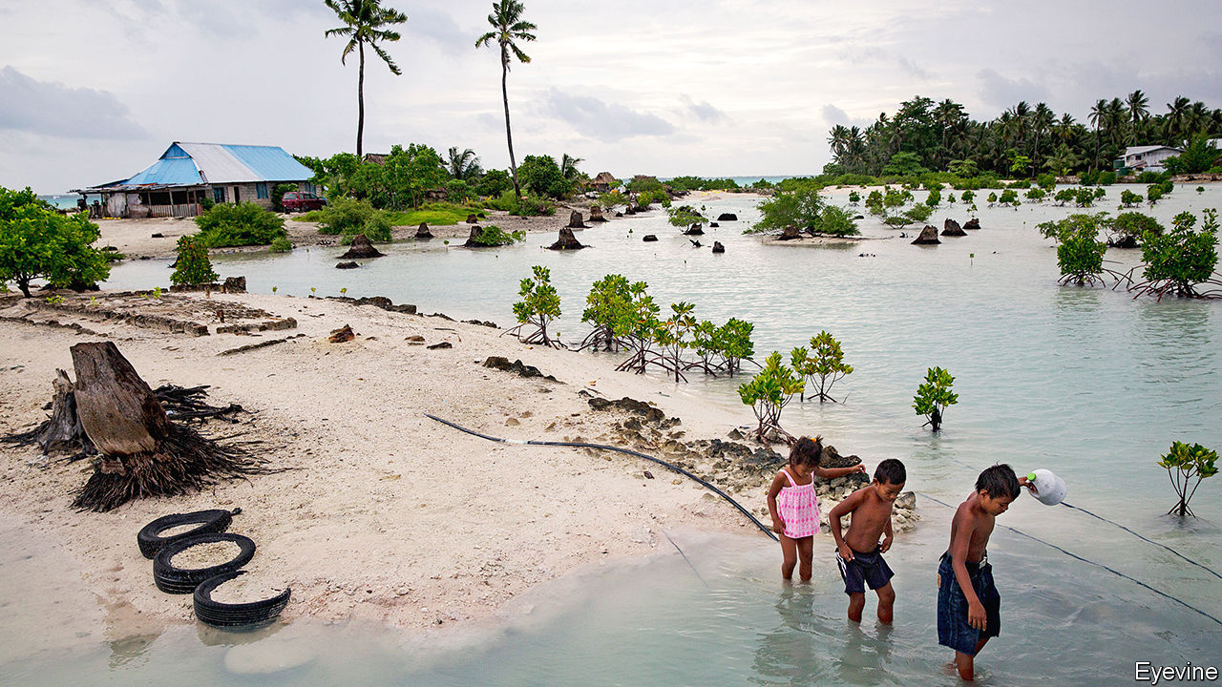
oceans are rising(rise)

Slide 9
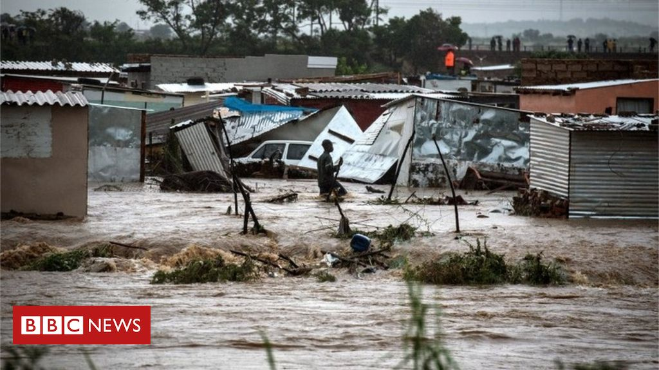
floods

Slide 10
coal oil natural gas

Slide 11
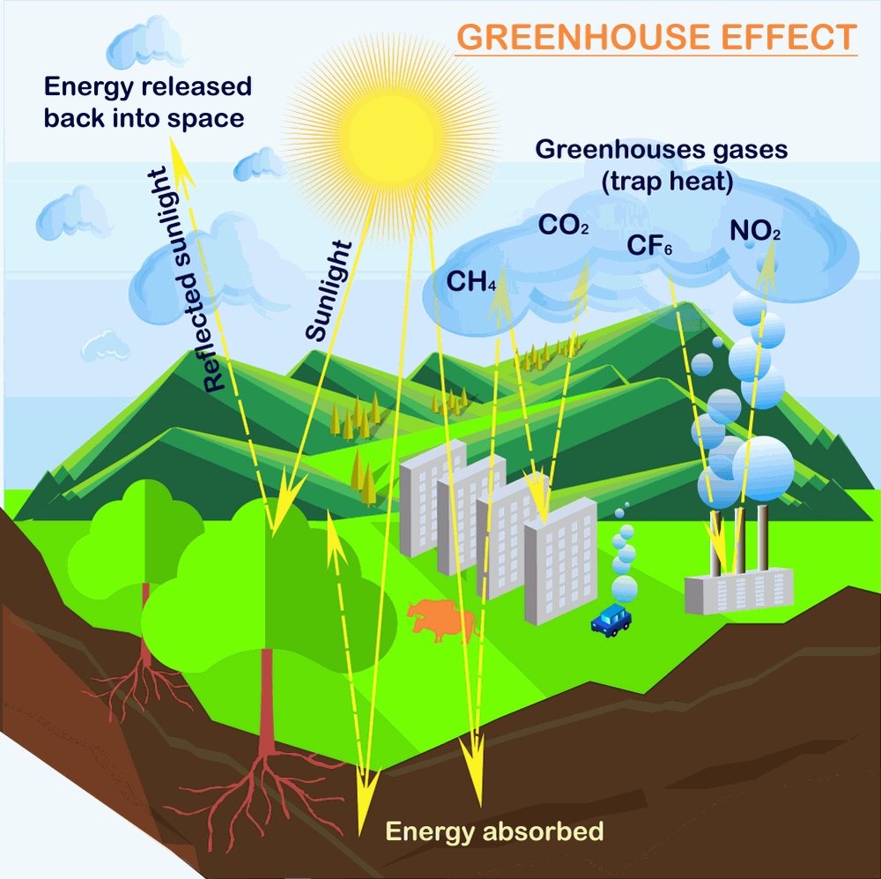
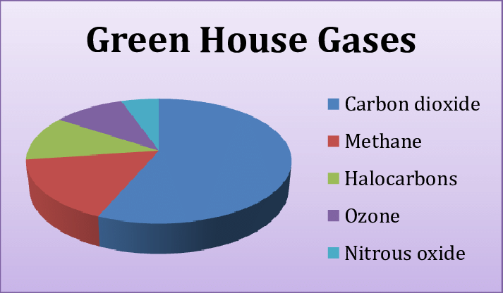
greenhouse gases

Slide 12
a blanket

Slide 13
the heat-trapping blanket

Slide 14
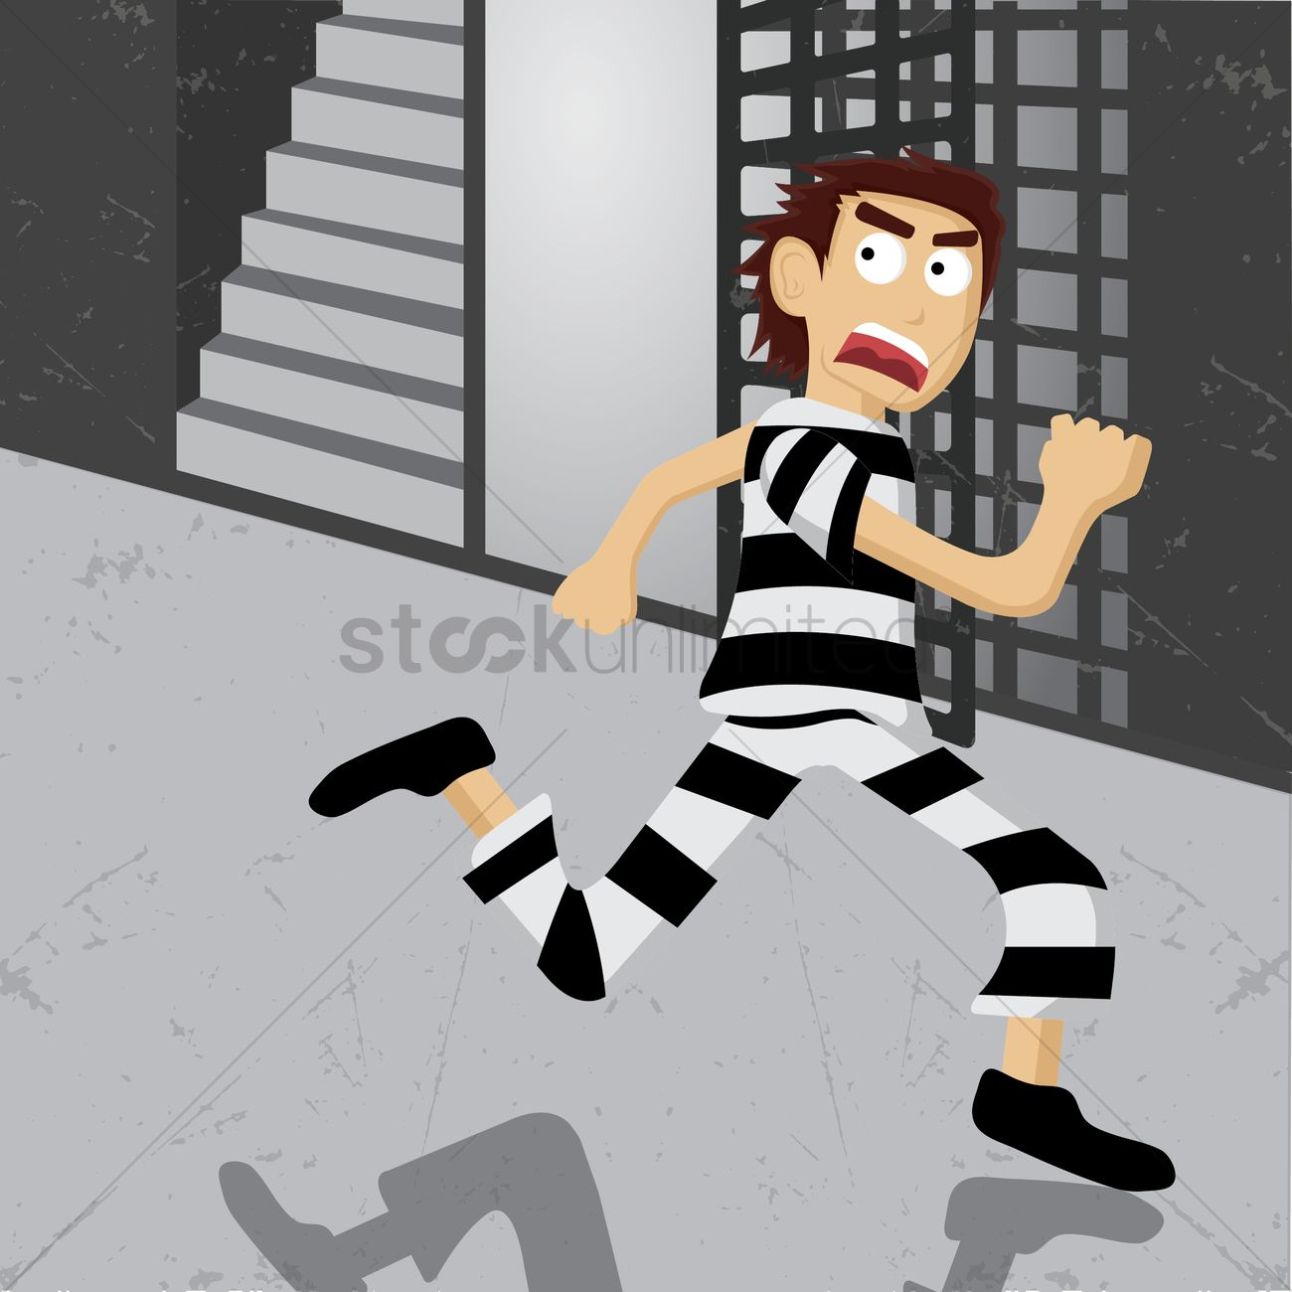
escape (escaping)

Slide 15
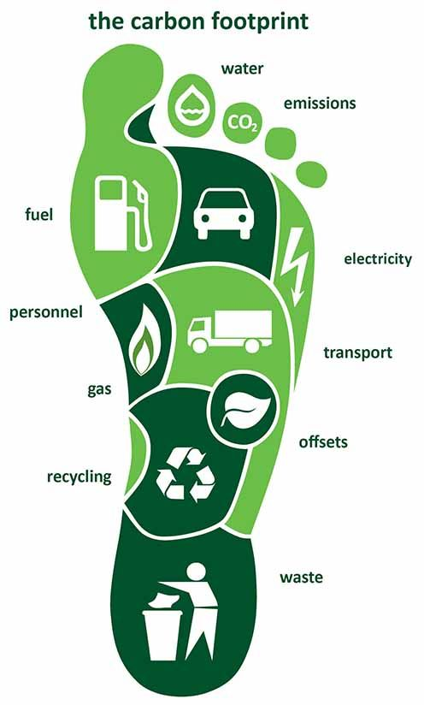
the carbon footprint

Slide 16
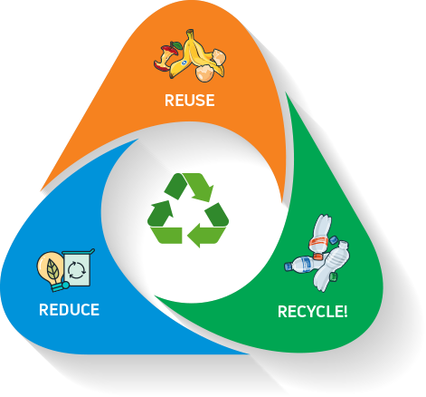
the 3 R’s of recycling

Slide 17
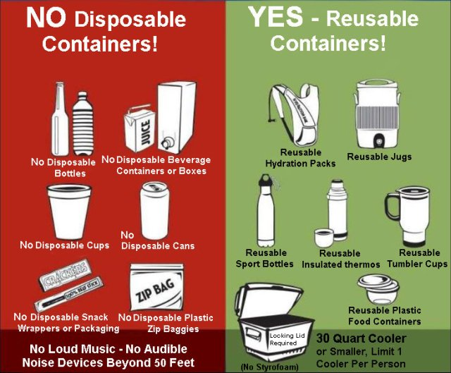
disposable (dispose)

Slide 18
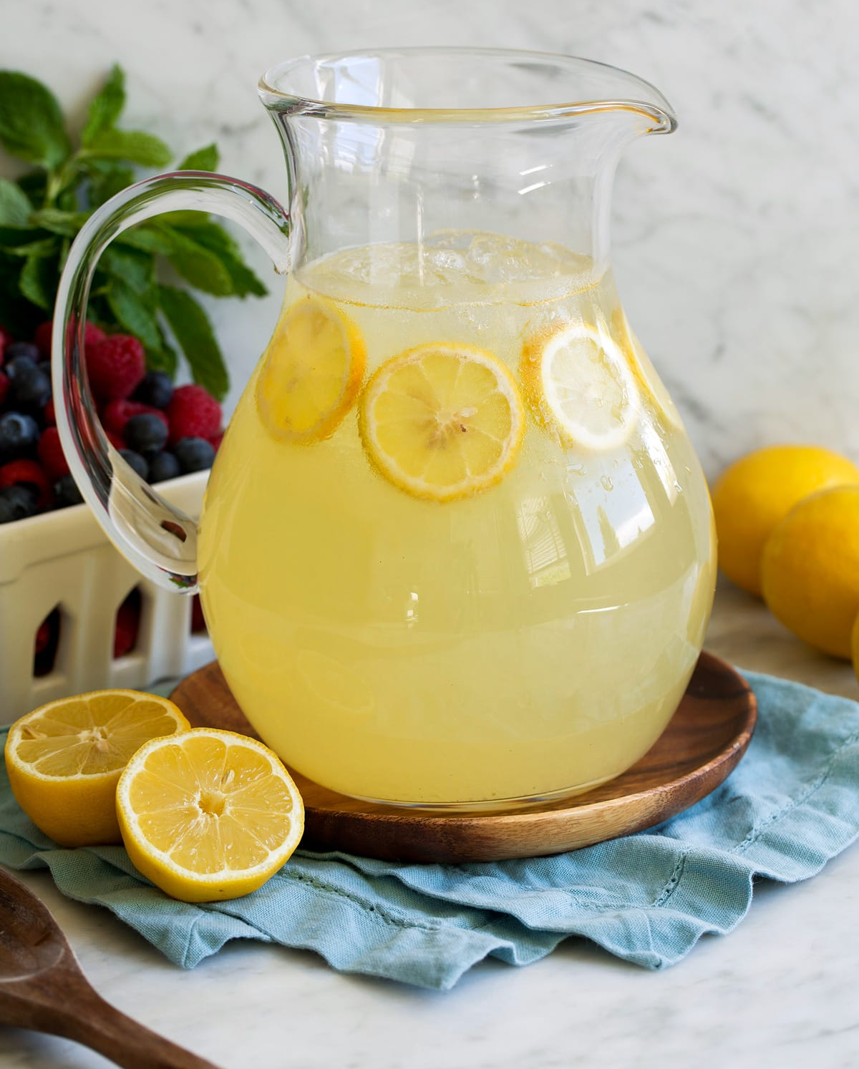
lemonade

Slide 19
energy

Slide 20
protein
plant protein
animal protein

Slide 21
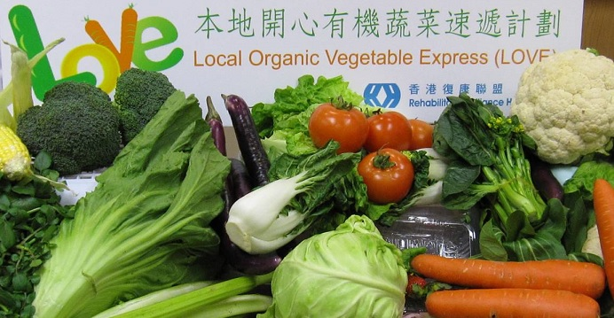
local vegetables

Slide 22
poetry / poems

Slide 23
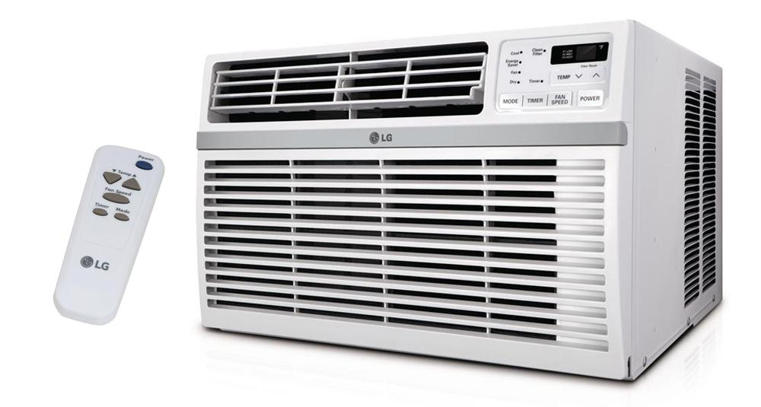
an air-con (air-conditioner)

