Slide 1
Chapter 2: Eye on the world
Children Worldwide
new words

Slide 2
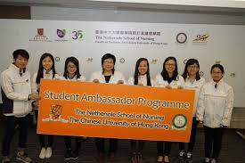
ambassadors

Slide 3
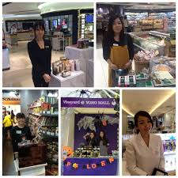
promote

Slide 4
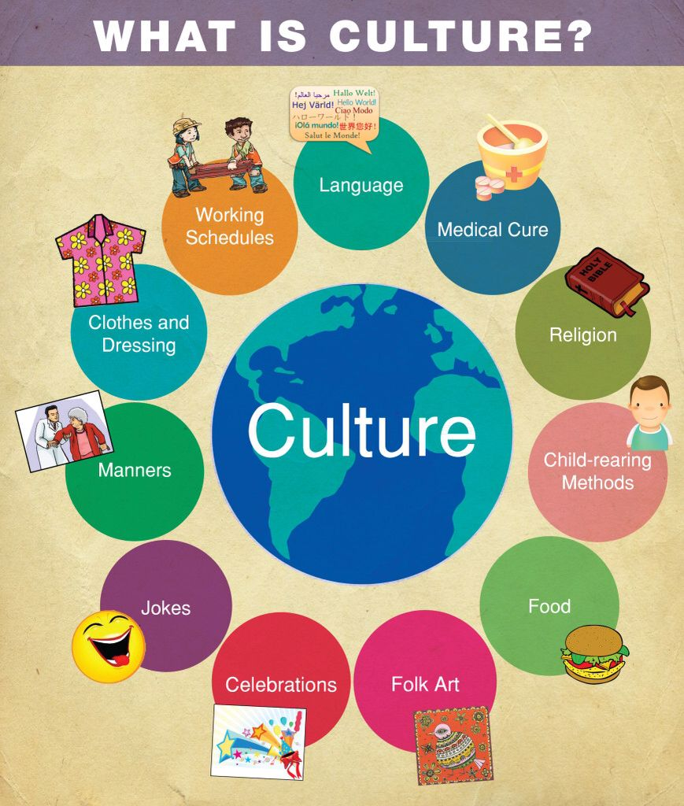
culture = a way of living

Slide 5
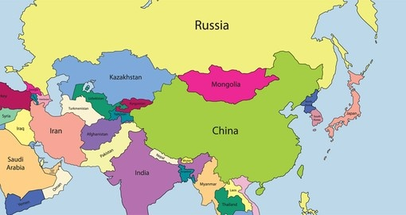
Monoglia

Slide 6
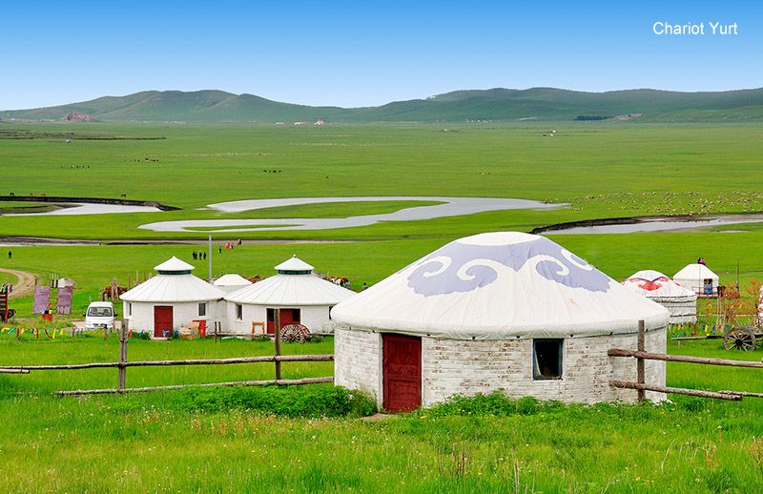
grassland
a ger
(a tent)

Slide 7
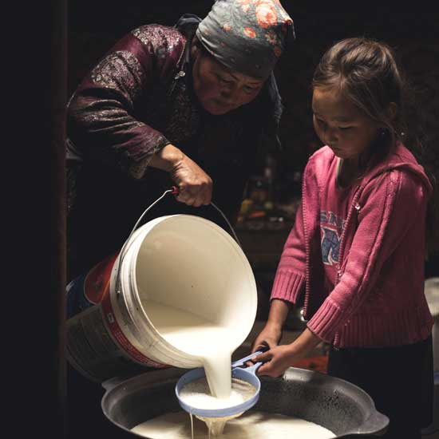
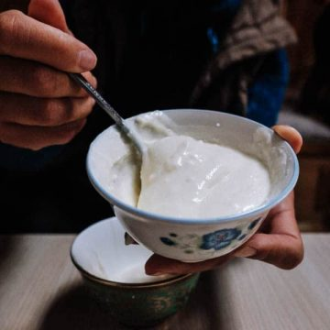
yoghurt in Mongalia

Slide 8
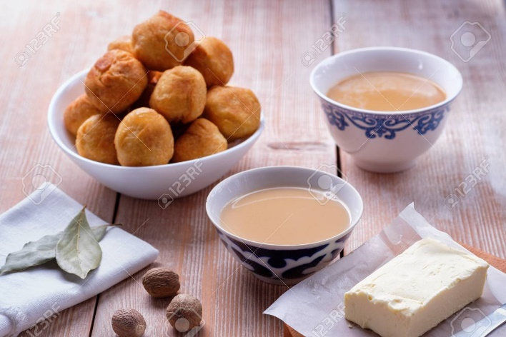
salty milk tea

Slide 9
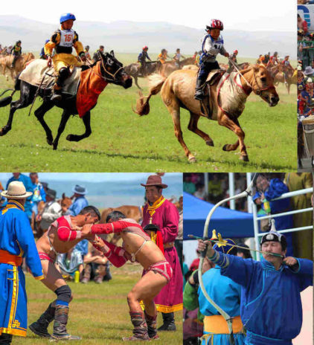
Naadam Festival
horse-racing
wrestling
archery

Slide 10
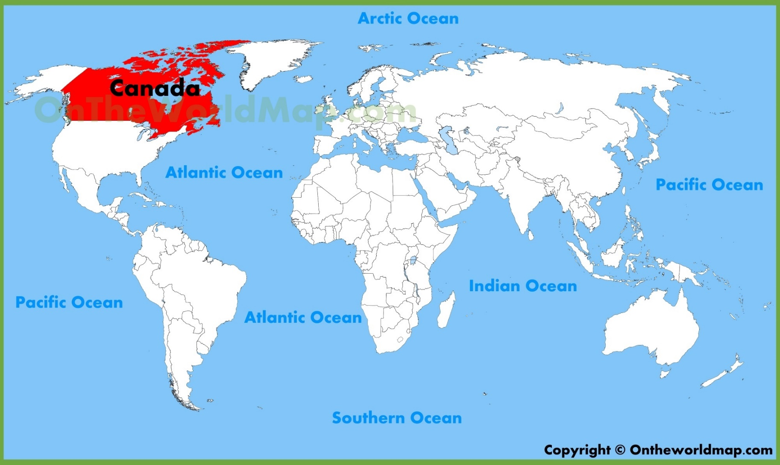
Canada

Slide 11
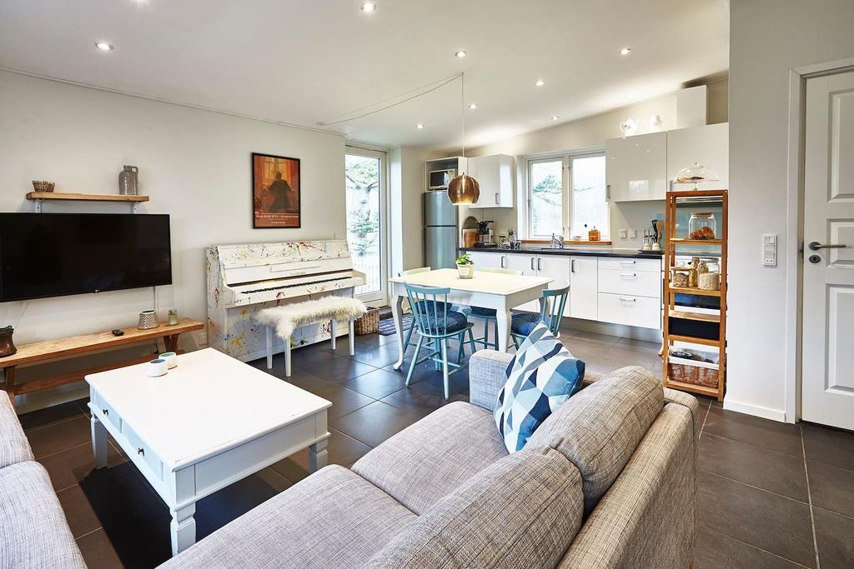
cosy (British English) cozy (American English)

Slide 12
a cosy house
a gym

Slide 13
do chores

Slide 14
mow the lawn

Slide 15
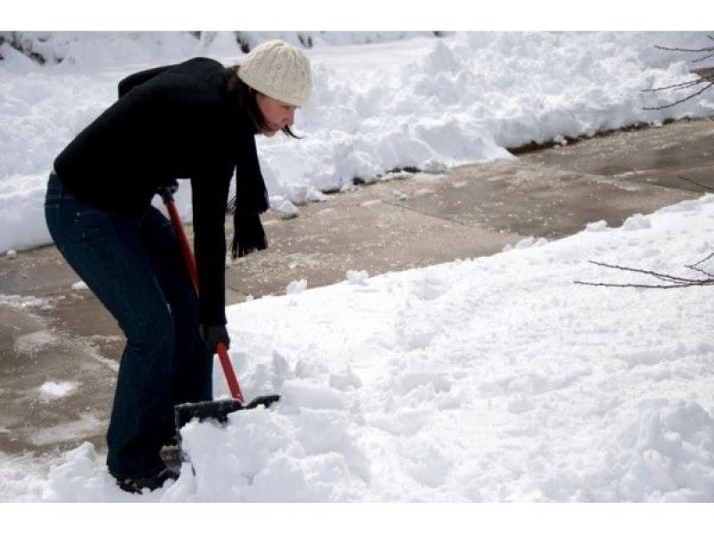
shovel the snow

Slide 16
skyscrapers

Slide 17
natural features

Slide 18
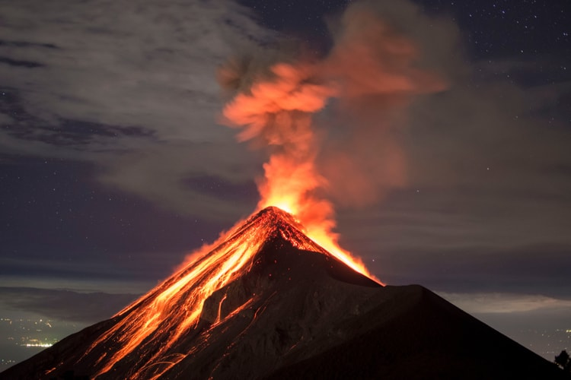
a volcano

Slide 19
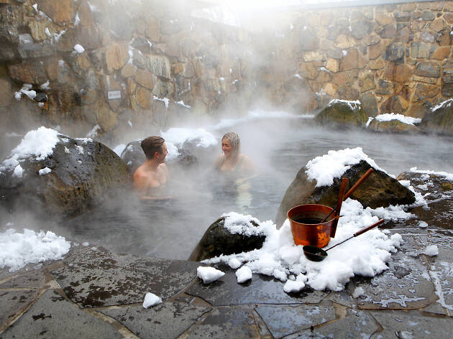
a hot spring

Slide 20
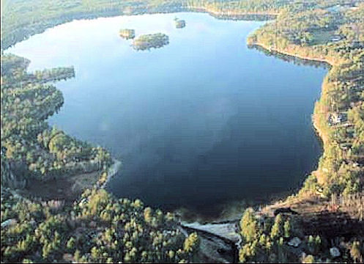
a lake

Slide 21
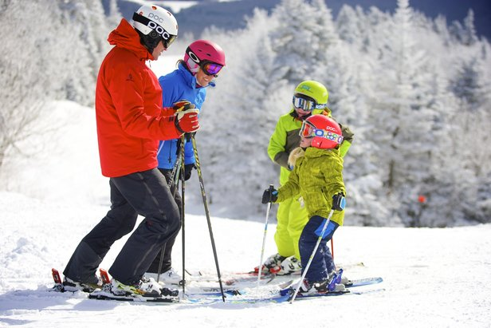
skiing

Slide 22
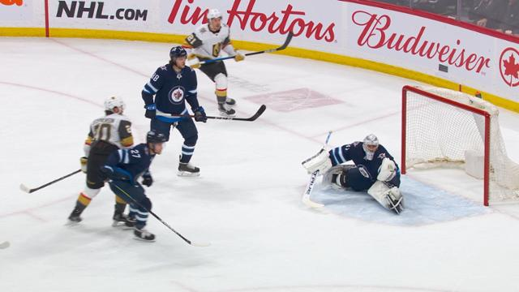
ice hockey

Slide 23
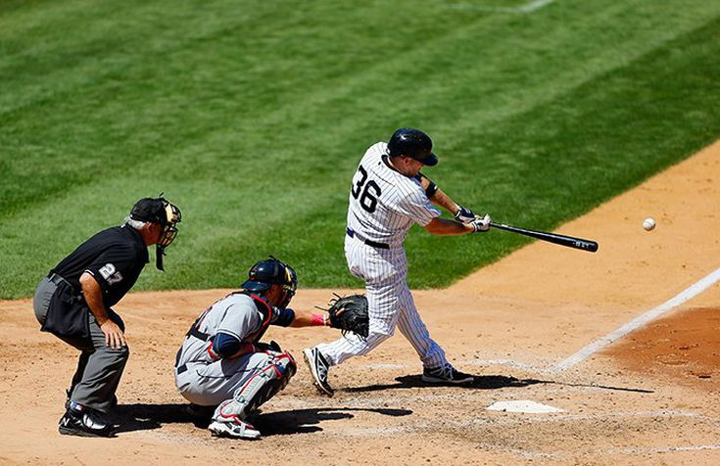
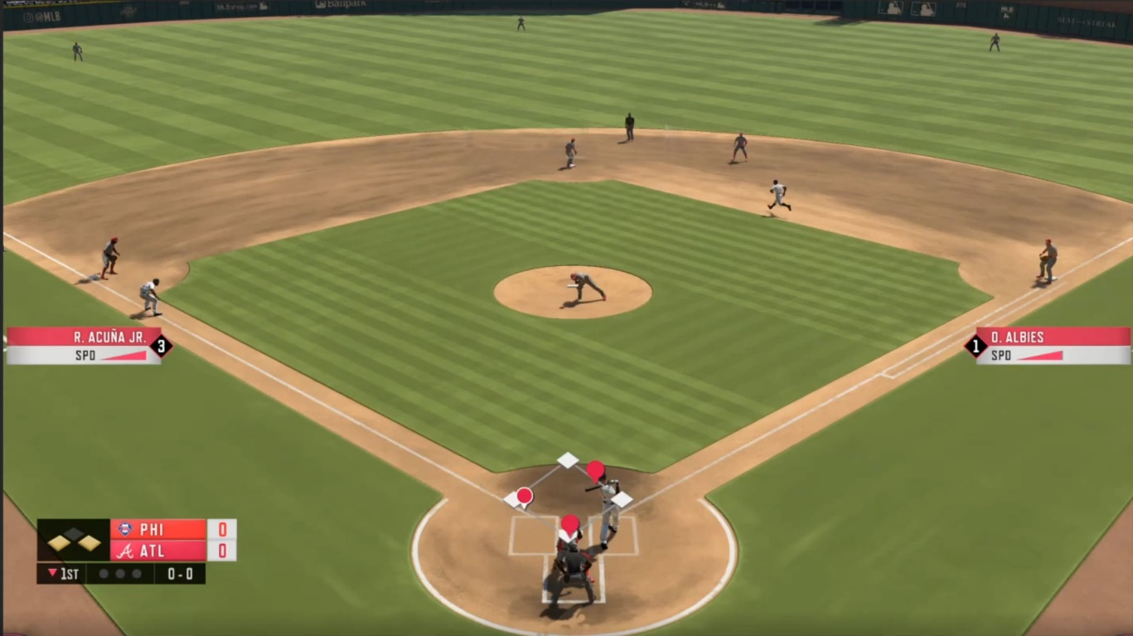
baseball

Slide 24
soccer

Slide 25
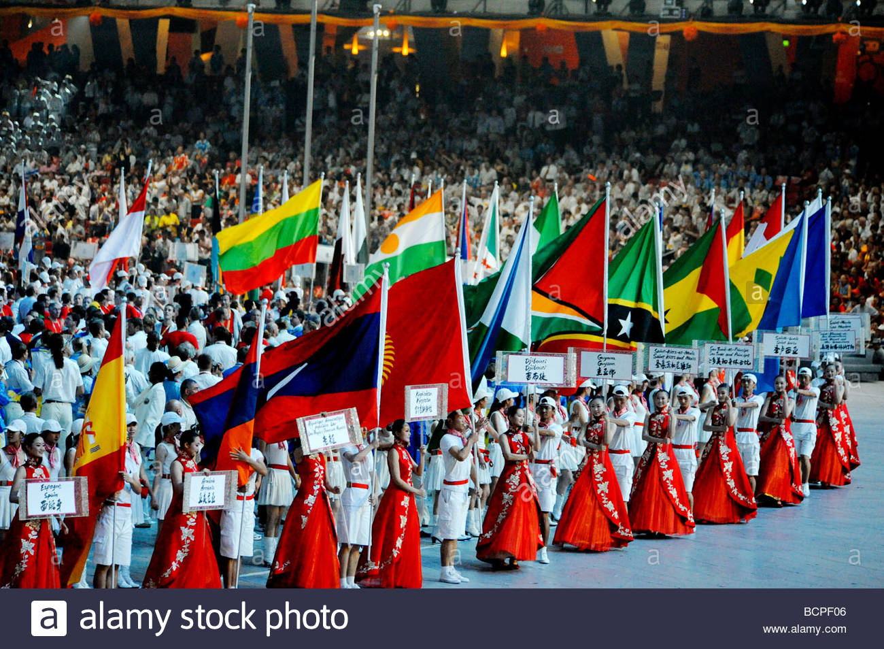
represent

Slide 26
the Winter Olympics

