Slide 1
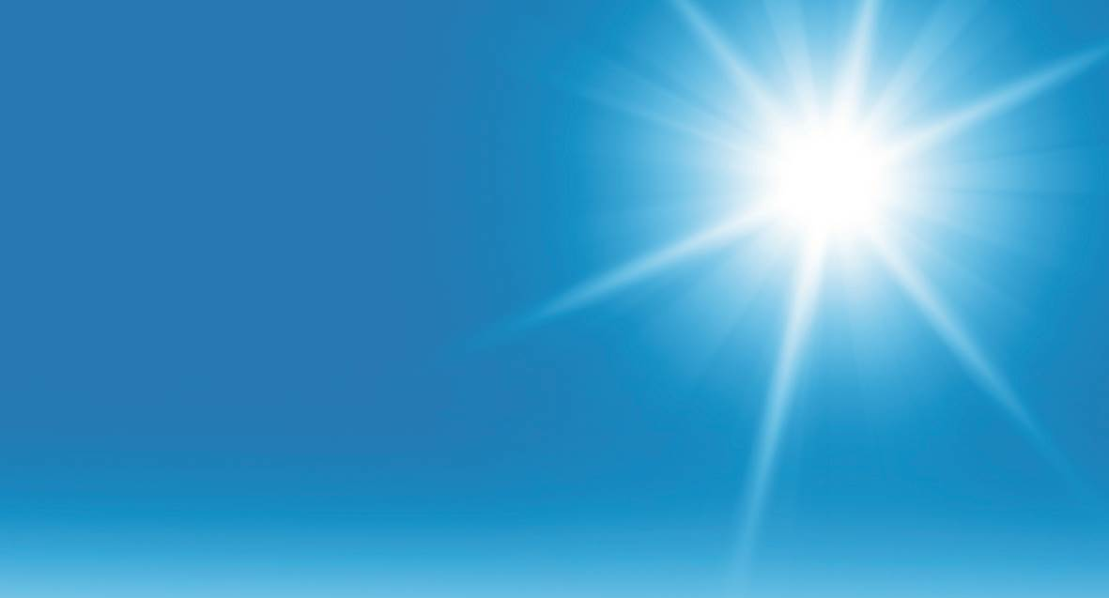
Book 5B
Chapter 2
Courseware for Teachers

Slide 2
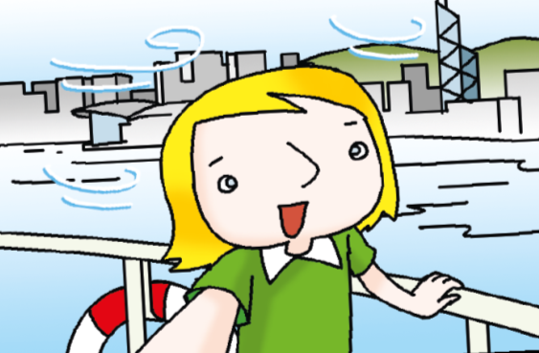
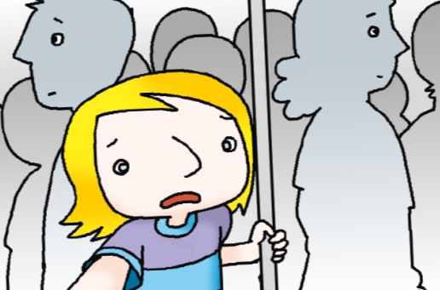
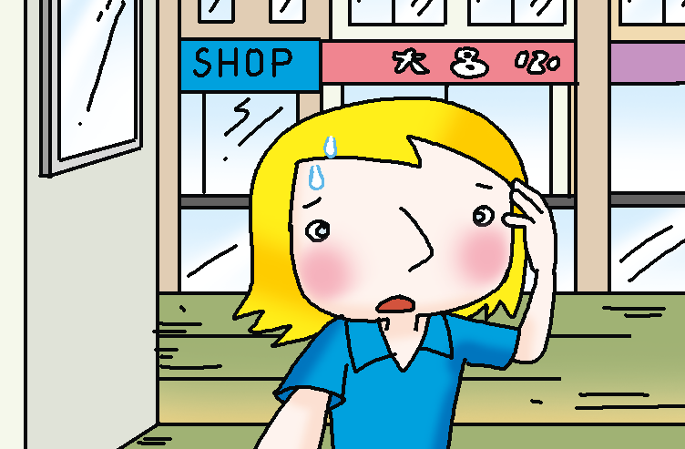
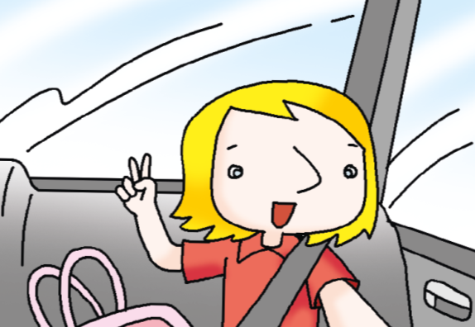
Introduction
Answers
The girl’s name is Lucy and she’s from the UK.
She found that the transport in Hong Kong is interesting so she’s writing an e-mail to her friend Kelly about it.
She moved to Hong Kong two months ago.
Today we’re going to help a girl finish her e-mail.

Slide 3
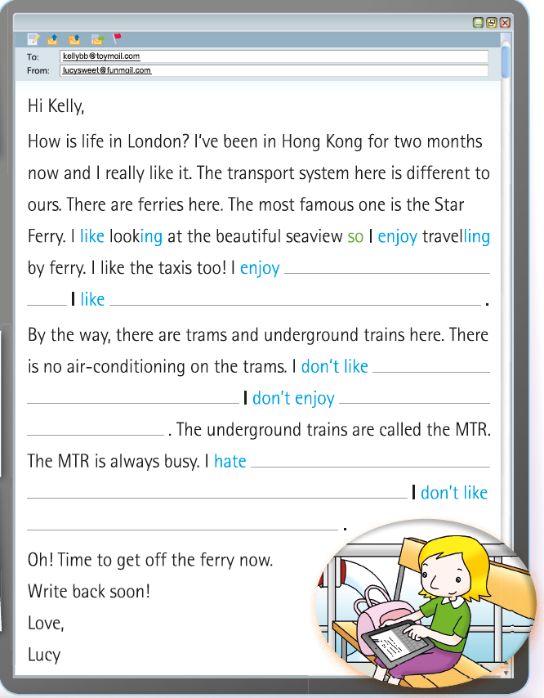
Introduction
Answers
This is Lucy’s e-mail to Kelly.

Slide 4
Introduction
Answers
Some words are missing in the e-mail.
We’re going to help Lucy complete the e-mail by filling in the blanks.

Slide 5
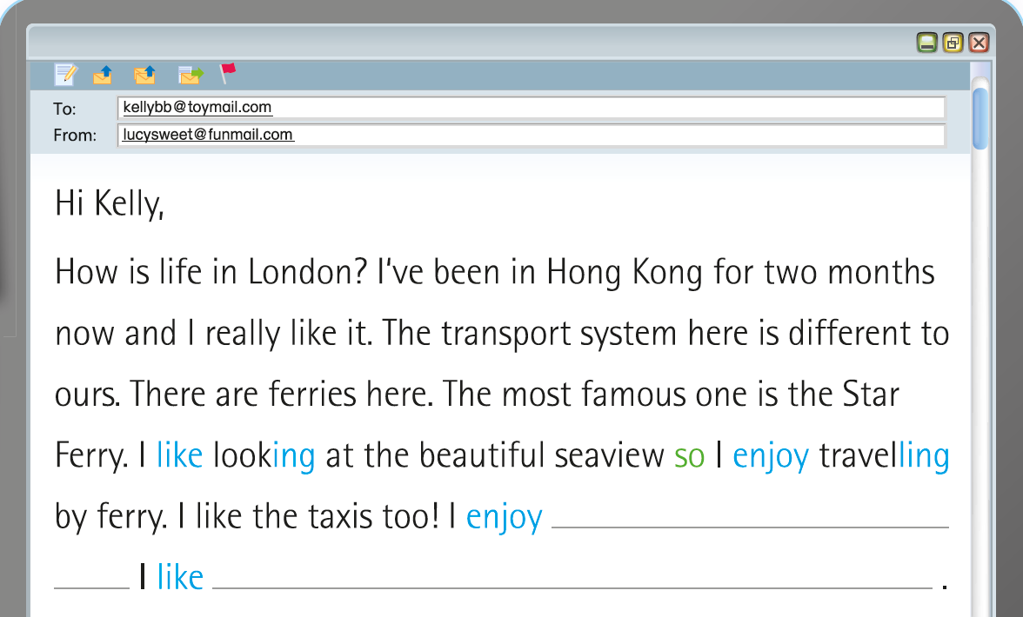
Introduction
Answers
Look at the nice view!
Lucy is on a ferry.

Slide 6
Introduction
Answers
Look at the nice view!
Do you think she likes travelling by ferry?
Yes!

Slide 7
Introduction
Answers
Look at the nice view!
So she writes …
like
ing
so
enjoy
ling

Slide 8
Introduction
Answers
Look at the nice view!
It’s nice and relaxing here!

Slide 9
Introduction
Answers
What does Lucy like about this transportation?
It’s nice and relaxing here!

Slide 10
Introduction
Answers
It’s nice and relaxing here!
So she writes …
sitting comfortably
so
travelling by taxi

Slide 11
Introduction
Answers
Let’s take a quick look at the rest of the e-mail.
Good job!

Slide 12
Introduction
Answers
Complete the first part of the sentences by looking at Lucy’s pictures and choosing the correct words from the box.
It’s hot here!
My legs hurt!

Slide 13
Introduction
Answers
Then talk about the kind of transportation that Lucy likes / enjoys or doesn’t like / hates.
It’s hot here!
My legs hurt!

Slide 14
Introduction
Answers
Reason
Result
It’s hot here!
My legs hurt!

Slide 15
Introduction
Answers
Reason
Result
It’s hot here!
feeling
hot so
travelling
by tram
My legs hurt!

Slide 16
Introduction
Answers
Reason
Result
It’s hot here!
feeling
hot so
travelling
by tram
My legs hurt!

Slide 17
Introduction
Answers
Reason
Result
It’s hot here!
feeling
hot so
travelling
by tram
standing for so long
so
travelling by MTR
My legs hurt!

Slide 18
Introduction
Answers
sitting comfortably
so
travelling by taxi
feeling
hot so
travelling
by tram
standing
for a long time so
travelling / to travel by MTR

Slide 19
Excellent!

Slide 20
Acknowledgments
We are grateful to the following for permission to reproduce copyright photographs:
Ljupco Smokovski. Shutterstock for slides 2, 12, 15, 20 & 22
Every effort has been made to trace copyright, but in the event of any accidental infringement, we shall be pleased to come to a suitable arrangement with the rightful owner.

