Slide 1
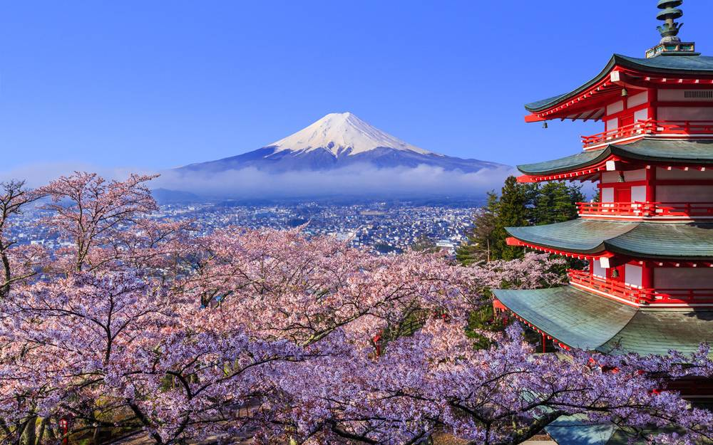
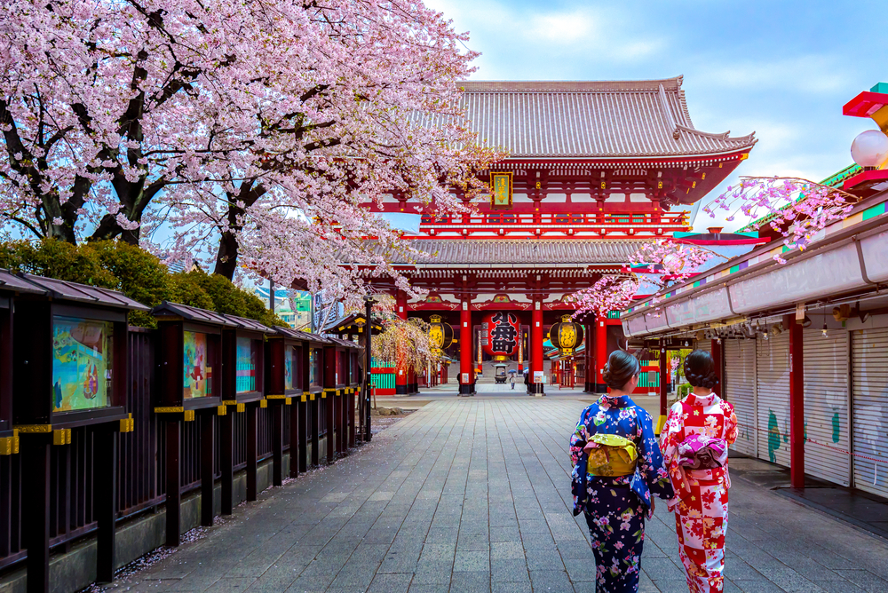
2014 2016

Slide 2
I went to Japan in 2014.

Slide 3
I went to Japan in 2014.
I went to Japan again in 2016.

Slide 4
I went to Japan in 2014.
I went to Japan again in 2016.
I have travelled outside Hong Kong two times.

