Slide 1
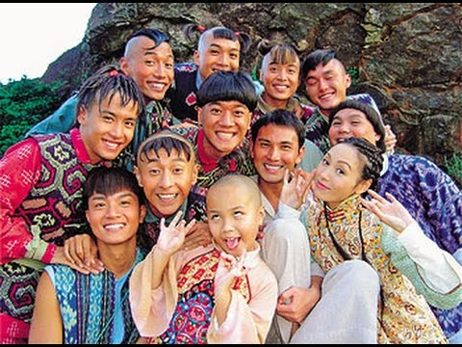
The Ten Brothers (Part 1)
The Ten Brothers

Slide 2
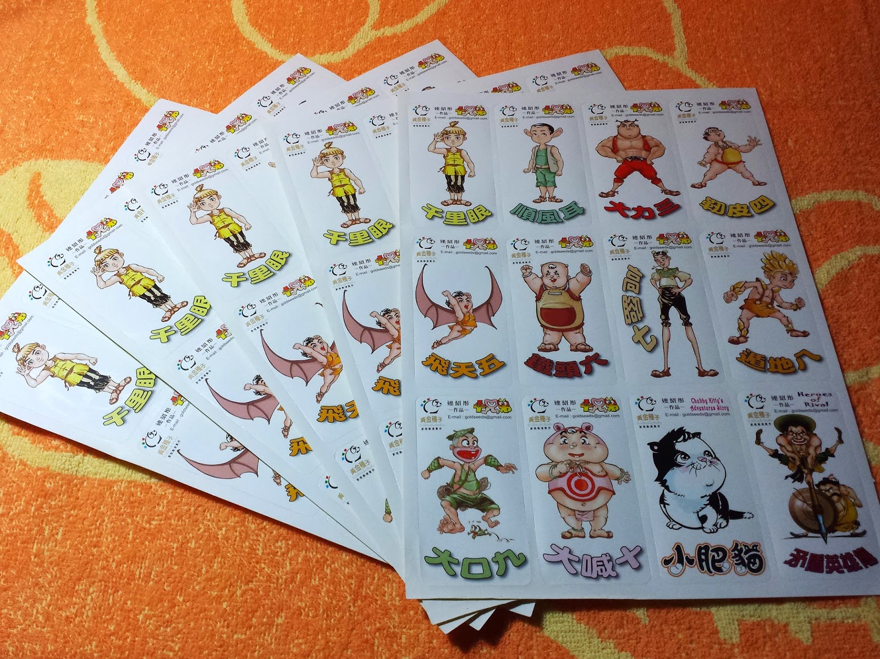

Slide 3
Special powers
 | Special powers
Brother 1
Brother 2
Brother 3
Brother 4
Brother 5
Brother 6
Brother 9
Brother 10

Slide 4
Special powers
 | Special powers
Brother 1 | can see things that are miles away
Brother 2
Brother 3
Brother 4
Brother 5
Brother 6
Brother 9
Brother 10

Slide 5
Special powers
 | Special powers
Brother 1 | can see things that are miles away
Brother 2 | can hear a cry miles away
Brother 3
Brother 4
Brother 5
Brother 6
Brother 9
Brother 10

Slide 6
Special powers
 | Special powers
Brother 1 | can see things that are miles away
Brother 2 | can hear a cry miles away
Brother 3 | very strong
Brother 4
Brother 5
Brother 6
Brother 9
Brother 10

Slide 7
Special powers
 | Special powers
Brother 1 | can see things that are miles away
Brother 2 | can hear a cry miles away
Brother 3 | very strong
Brother 4 | can stretch his arms
Brother 5
Brother 6
Brother 9
Brother 10

Slide 8
Special powers
 | Special powers
Brother 1 | can see things that are miles away
Brother 2 | can hear a cry miles away
Brother 3 | very strong
Brother 4 | can stretch his arms
Brother 5 | can fly
Brother 6
Brother 9
Brother 10

Slide 9
Special powers
 | Special powers
Brother 1 | can see things that are miles away
Brother 2 | can hear a cry miles away
Brother 3 | very strong
Brother 4 | can stretch his arms
Brother 5 | can fly
Brother 6 | can think hard
Brother 9
Brother 10

Slide 10
Special powers
 | Special powers
Brother 1 | can see things that are miles away
Brother 2 | can hear a cry miles away
Brother 3 | very strong
Brother 4 | can stretch his arms
Brother 5 | can fly
Brother 6 | can think hard
Brother 9 | can speak very loudly
Brother 10

Slide 11
Special powers
 | Special powers
Brother 1 | can see things that are miles away
Brother 2 | can hear a cry miles away
Brother 3 | very strong
Brother 4 | can stretch his arms
Brother 5 | can fly
Brother 6 | can think hard
Brother 9 | can speak very loudly
Brother 10 | can heal people

