Slide 1
Getting on with others

Slide 2
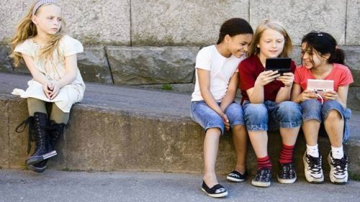
Getting on with others
How would you feel if you talked to your friend but he turned his back to you?

Slide 3
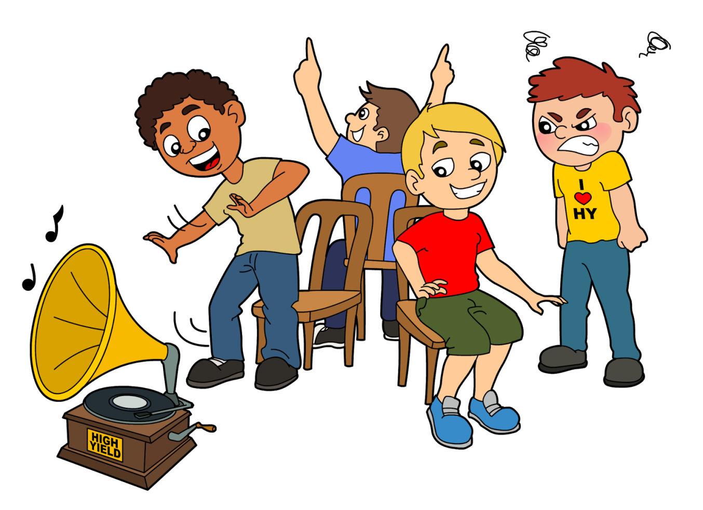
Getting on with others
How would you feel if someone pushed you out of the way to get the seat you were about to sit on?

Slide 4
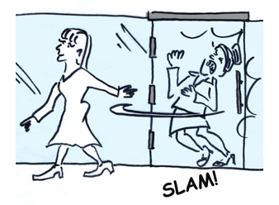
Getting on with others
How would you feel if someone let the door slam in your face as you were about to walk through it?

Slide 5
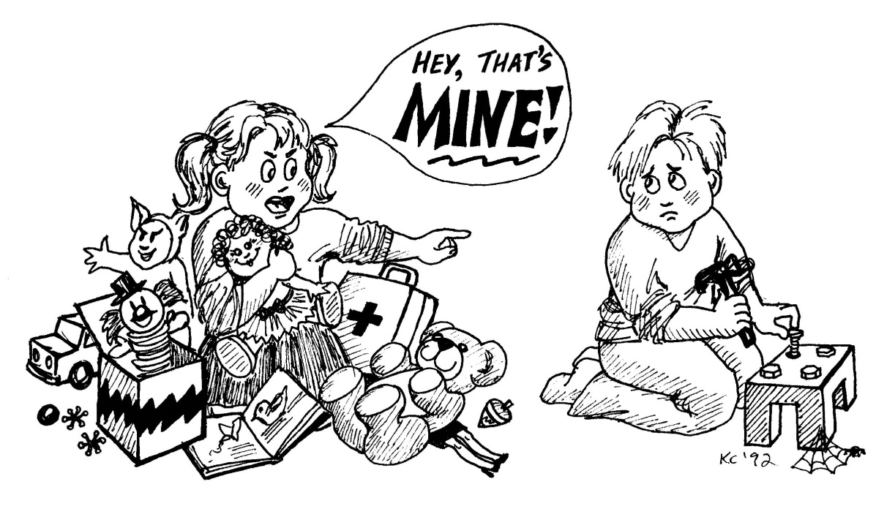
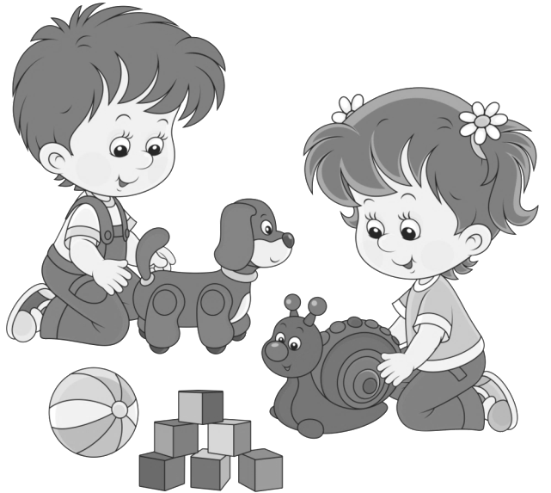
Getting on with others
How would you feel if someone shared your things but never shared anything of his?
Let’s play together!

Slide 6
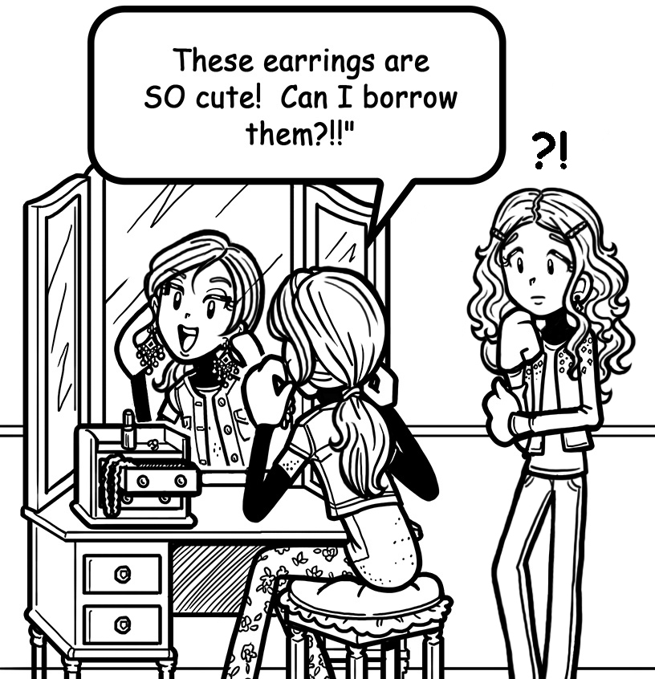
Getting on with others
How would you feel if someone never said ‘please’ or ‘thank you’?
These earrings are cute. I will take them!

Slide 7
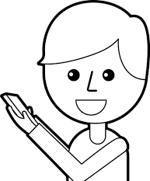
Getting on with others
How would you feel if someone didn’t pass your phone message to your friend?
Oh! What is the message?
Never mind, no big deal!

Slide 8
Getting on with others
You may be sad, angry, mad, disappointed, and so on if someone does not have good manners.
What do we mean by ‘Good manners’?
Good manners mean considering the feelings of other people, and being the kind of person that others like and respect.
The Golden Rule: “Do unto others as you would
have them do unto you.”

